Slide 1
SOCIAL REPRESENTATIVES
2018-2019

Slide 2
TRAINING AGENDA
The role of Social Reps
Thinking about types of events to run
Best ways to approach staff
Event ideas

Slide 3
BRAINSTORMING: BEST EVENTS
What is the best social event in St Andrews that YOU’VE ever experienced?

Slide 4
THE ROLE OF SOCIAL REPS
Idea
sharing
Cross-school
Feedback
collection
Student-staff
relations
Knowledge
building
Community

Slide 5
EDUCATION DISCRETIONARY FUND
2018/19 — £6500
doed@st-andrews.ac.uk
Notes:
https://www.yourunion.net/voice/academicreps/educationdiscretionaryfund/

Slide 6
EVENT CONSIDERATIONS
Audience
Catering
Venue
Speakers
Inclusivity
Invitations
Timing
Inter/Intra School
Costs
Post-event admin

Slide 7
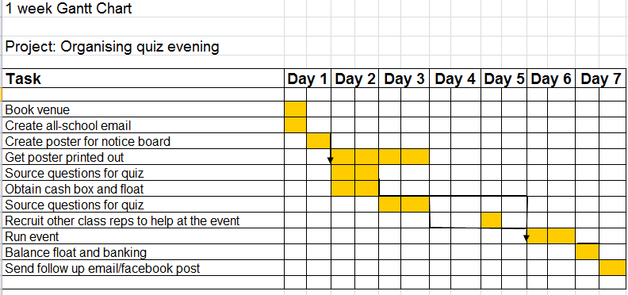
EVENT PLANNING: GANTT CHART
Plan in advance
Organise the tasks
Spread your workload
Collaborate and Delegate
http://www.youtube.com/watch?v=sA67g6zaKOE&feature=youtu.be

Slide 8
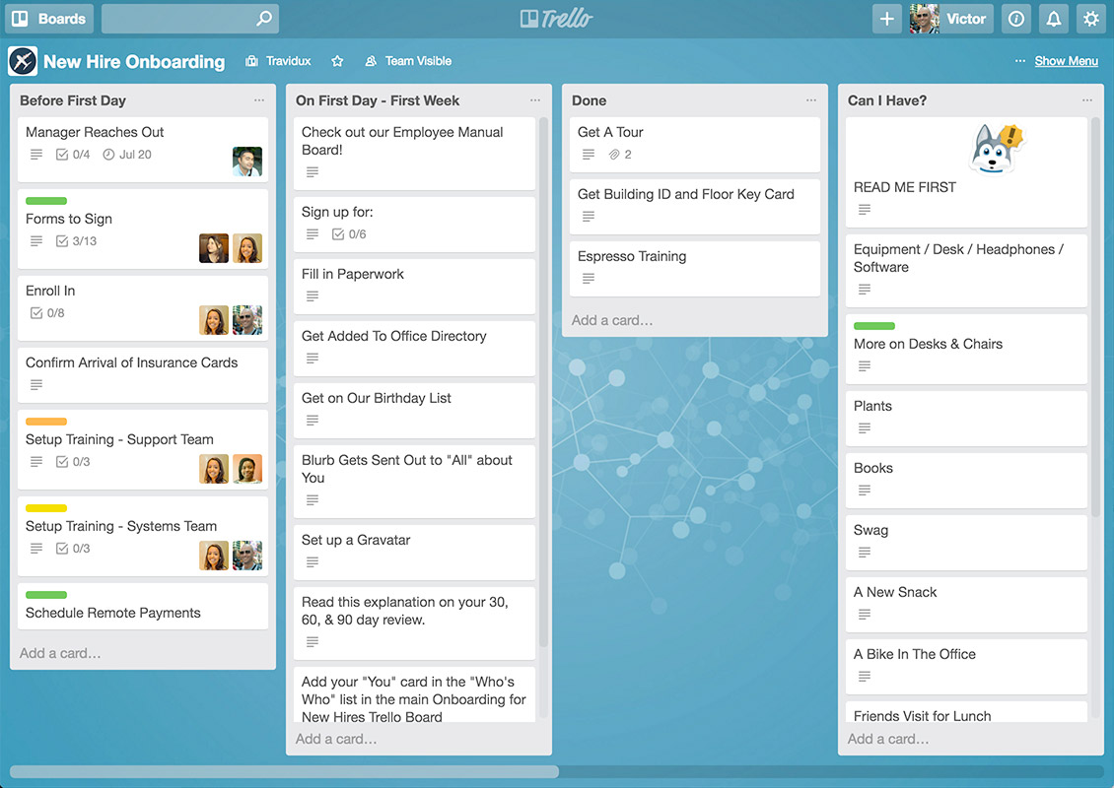
EVENT PLANNING: TRELLO
https://trello.com/

Slide 9
TIPS FOR APPROACHING STAFF: OBJECTIVES
Have clear objectives in mind
What is the event going to achieve?
Why will your School be better because of it?

Slide 10
TIPS FOR APPROACHING STAFF: RECOGNITION
Recognise that they’re busy
Set their time expectations
Why them and not someone else?

Slide 11
TIPS FOR APPROACHING STAFF: PLANNING
Have a thought-through plan
How can it fit their busy schedule?
Make clear what you are doing that is already in place to make the event a reality
Notes:
Alice

Slide 12
TIPS FOR APPROACHING STAFF: DELEGATION
Spread the load
Can new members of staff contribute?
Who may appreciate the invitation?

Slide 13
TIPS FOR APPROACHING STAFF: ACKNOWLEDGEMENT
Acknowledge their contribution (in writing)
What was their impact on the event?
What efforts had they gone to?

Slide 14
EVENT IDEAS
In pairs, think of three ideas for events
Scope out a simple Gannt chart for one

Slide 15
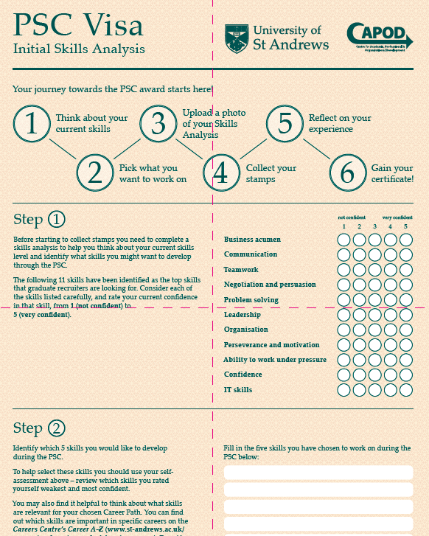
PROFESSIONAL SKILLS CURRICULUM
Development programme open to all students
11 graduate skills relevant to Class Reps and Employment
Dip in and out, or complete 8 and a reflective essay to receive certificate
https://www.facebook.com/ ProfessionalSkillsCurriculum
Notes:
Award is also listed on your HEAR degree transcript

Slide 16
AWARDS AND RECOGNITION
Class Representative Awards
Proctor’s Award — recognises excellent work of Class Reps
“To recognise amazing commitment by students in enhancing learning and teaching in the University”

