Slide 1
Societies Treasurers’ Training
2017-18

Slide 2
Contacts
Societies Grants Officer
socgrant@st-andrews.ac.uk
Charlotte, DoSDA@ and Phil, prh@
Societies Committee Office Hours
4-6pm Mondays
Main Bar of the Union
Email grant ahead of time or just come in with questions

Slide 3
Contacts
Cash office
Middle Floor of the Union, turn right after the stairs
Jillian Cowan, Management Accountant
Cash office happy to help with accounts etc.

Slide 4
Responsibilities
Account Keeping
Financial Practices
Budgeting
Funding
Anti-Fraud Practices
Treasurer's Competency Assessment

Slide 5
1. Account Keeping
Notes:
the first fun part

Slide 6
Basic Principles
Single-Entry Bookkeeping
The standard method of accountancy for societies is single-entry bookkeeping
Income and expenditure is recorded only once in the cash book
A cash book consists of all cash receipts and payments for both a society’s petty cash account and bank account
In a single-entry bookkeeping system, the cash book is the principal ledger

Slide 7
Cash Book
No | Date | Transaction | Cash Income | Cash Expenditure | Bank Income | Bank Expenditure
1 | 1 Sept 2017 | Carry Over Balances | £0.00 |  | £300
2 | 12 Sept 2017 | Membership Fees | £75
3 | 12 Sept 2017 | Tesco: Candy for Freshers Fayre |  | £10
4 | 13 Sept 2017 | Cash to Bank |  | £50 | £50
5 | 15 Sept 2017 | Print Shop: Freshers Flyers (#01392) |  |  |  | £22.50
6 | 17 Sept 2017 | Membership Fees | £45
7 | 13 Sept 2017 | Cash to Bank |  | £45 | £45
8 | 20 Sept 2017 | PWC: Sporsorship |  |  | £150
9 | 30 Sept 2017 | Balances to Carry-Over | £15 | £522.50
( )-( )
( )-( )
Sum of
Cash
income
Sum of
Cash
Expenditure
Sum of
Bank
income
Sum of
Bank
Expenditure
‹#›
Notes:
** teach about cheques: record cheque # and it comes from bank balance
‹#›

Slide 8
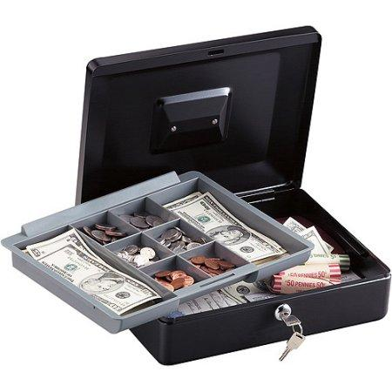
Records
As well as a Cash book and all receipts you must keep:
Bank statements from the last 7 years of your society
A lockable cash box, to keep all cash in
Cheque books (stored securely) and your Paying in book

Slide 9
Audits
Biannual Audit
Accounts due in December and May every year.
At both audits you must submit
All bank statements issued since the previous Audit
Cataloged receipts for society expenditure since the previous audit
Complete record of income and expenditure (i.e. a cash book)
Cheque book and paying-in book

Slide 10
2. Financial Practices
Notes:
the “un-fun” part

Slide 11
Permissible use of Society Funds
A society’s funds belong to and are derived from the members of the society
A society’s funds may only be used for the benefits of the society as a whole or for the fulfillment of its aims
No member of the Committee may derive any financial profit or gain by reason of his/her participation on the Committee, including favourable rates on goods or services, unless the same benefit is available to any and all members of the Society.

Slide 12
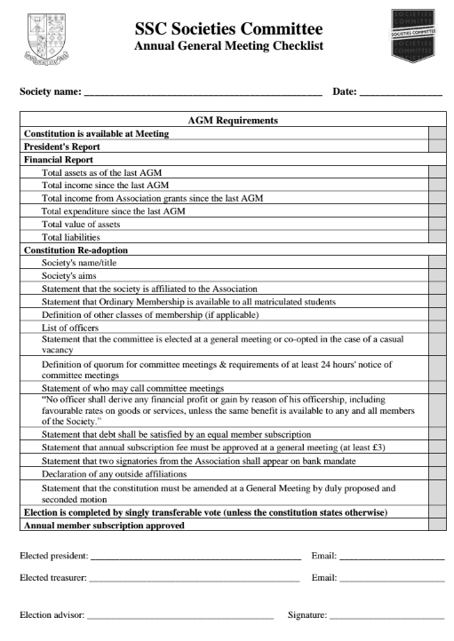
Treasurer's Report
At a society’s annual general meeting (AGM), a society’s treasurer or his nominee shall present a report to the meeting detailing:
Total assets at the time of the previous AGM
Total income since the previous annual general meeting
Total income from Association grants since the last AGM
Total expenditure since the previous AGM
Current total assets
Any debts including loans from the Societies Committee
Don’t worry, this is all on the AGM checklist.

Slide 13
Transparency and Accountability
Societies’ accounts must be totally transparent
They must be maintained in a standard format
They must document ALL income and expenditure
Societies are accountable to the Association and their members for their financial practices
Accounts must be updated regularly and made available upon request

Slide 14
Cash Management
Cash may only be handled by those authorised to do so
Cash boxes are insured for up to £200.00
Cash outside of your box is not insured.
Never keep more than £200.00 in your cash box for more than 1 day
The Cash Office can provide floats (change)
The Association can provide secure storage for your cash box over night/weekends if the balance is more than £200

Slide 15
Reimbursements
Payment should be by cheque when possible because they are more trackable
Purchases made from local merchants may be paid from petty cash
For online purchases, you should use the Cash Office’s credit card and write a cheque to the Association

Slide 16
Banking
Societies may only hold one bank account without leave of the Societies Committee (supplemental accounts must be approved)
All mandates must include two members of the Association’s permanent staff as signatories
Jillian Cowan, Management Accountant
David Whitton, General Manager
All cheques must be signed by TWO signatories
All correspondence must be addressed to the Association and check your mailboxes
Correspondence will be placed in pigeonholes, which must be checked fortnightly
Know your cash book balance at all times and prevent bounced cheques

Slide 17
Fixed Assets
A fixed asset is a tangible piece of property that a society does not expect to be consumed or sold within one year
Societies must seek the permission of the Association Director of Student Development or Activities to sell or otherwise dispose of a fixed asset if purchased with Association funding
High value assets may be insured by the union at the discretion of the Management Accountant

Slide 18
Charitable Donations
All charitable donations must be processed through the Charities Campaign. Failure to do so will result in penalties.
The donation will still come from your society and will also count towards the total money for charity St Andrews raises
Speak to the Charitable Societies Coordinator (charitysocs@) for donations outside of the Campaign framework for emergency relief campaigns.
If you are a charitable society, please come to the Charitable Societies Round-table on 1st October at 2pm

Slide 19
3.Budgeting
Notes:
“The common sense” part

Slide 20
Budgeting Principles
As a treasure you need to protect your society's money and oversee financial expenditure. You should have budgets for every event run to ensure they are viable.
Income
Do NOT overestimate income
Income should be projected from past events, not from overly optimistic predictions, not every member will buy a ticket.
Ensure that any grant or sponsorship is guaranteed and available (i.e. not merely promised)
Securing cash-flow loans is generally inadvisable; such loans make the success of the event existential for your society

Slide 21
Budgeting Principles
Expenditure
Include ALL expenditure in your projections
Budget for a 10% sundry overrun on ALL expenses
Include VAT
Assume, for the purposes of budgeting, that the society will continue to exist and operate indefinitely
While the society may subsidise an event, it may not jeopardise the the financial future of the society

Slide 22
Good Practices in Budgeting
Do not budget to “break even”. Budget to run at least small surplus to avoid a deficit.
Create budgets for all events and activities and stick to them as nearly as possible. Do not wander into a financial commitment without a plan.
Preparing a budget is also an essential part of applying for funding from the union for an event.

Slide 23
4. Funding
Notes:
the second fun part

Slide 24
Sponsorship
Societies can look for external funding; this may come from
schools within the University
external companies

Slide 25
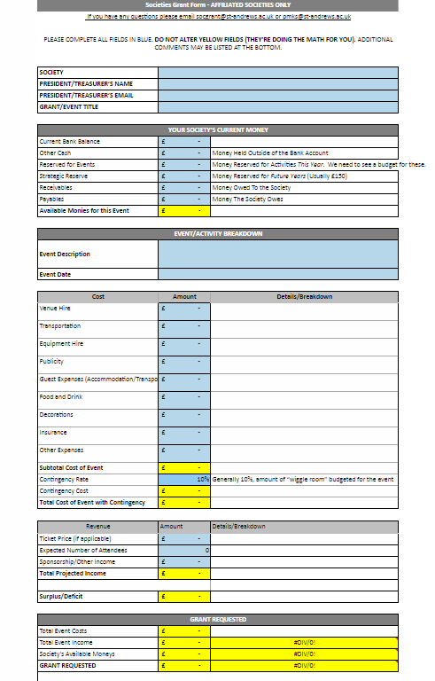
Societies Committee
Grants
The Societies Committee a budget of £35,000 to grant to societies and for the Society Awards
This money comes from profit in the union, through the shop, bars, corporate stands at the Freshers’ Fayre and other services
This is why when we fund an event we ask you to use union services where possible, see the website for what we can provide
We want to spend our budget so please apply for grants!

Slide 26
Applying for Grants
Step One: Email a completed from form to socgrant@ and come to our Office Hours, Tuesdays, 4-6pm in Main Bar. We’ll chat about your grant.
Step Two: The Societies Committee reviews grants at weekly on Wednesdays. If your grant is above £500, you’ll be asked to present the grant at the Societies Committee’s meeting.
Step Three: You should hear back about your grant by Friday of the same week. If you get a grant, you will receive a Grant Receipt via email.
Step Four: To claim your grant, just present receipts and the Grant Receipt to the Cash Office. We also ask that you mention the Societies Committee in your Facebook event description or in any other pertinent press.
A blank grant form can be found on the Union website or by emailing socgrant@ and remember, the form does all the math for you!

Slide 27
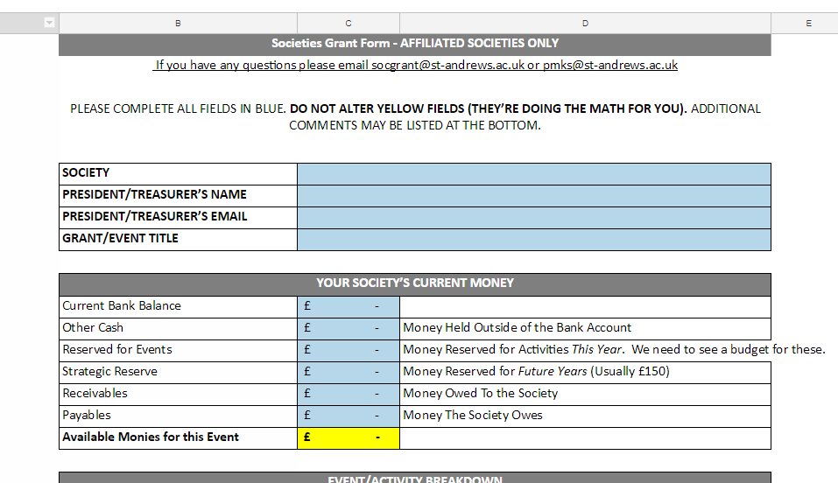
Society’s Current Money
The society may keep a strategic reserve to protect the society from unexpected expenditure.
This will be a quarter of the society's annual bank expenditure, or £150 whichever is greater.
This amount cannot exceed £750, unless a society can prove to the Societies Committee it is strategically justifiable to hold a greater reserve.
If you have any questions, please email socgrant@
or come to our Office Hours, Tuesdays, 4-6pm in Main Bar.

Slide 28
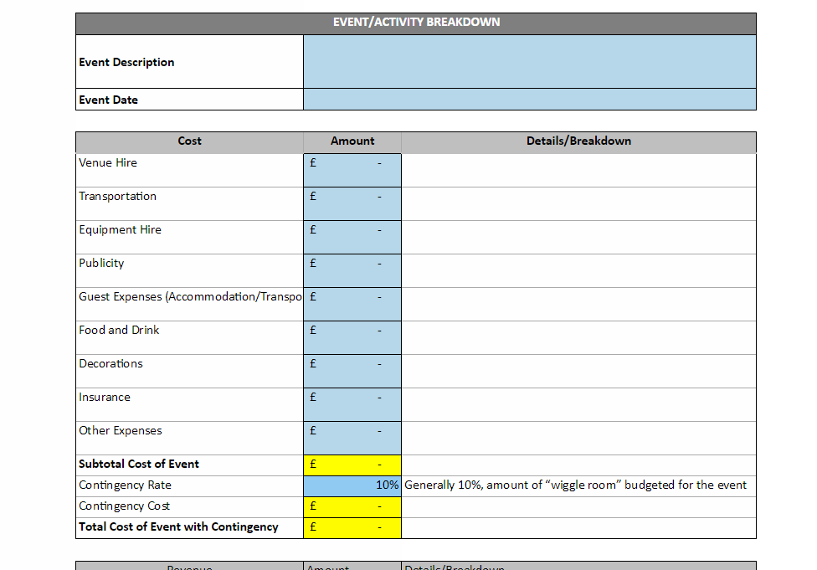
Event
Expenditure
The boxes on the left are suggested categories of expenditure. You don’t have to use all of them.
Contingency allows for you to budget in some ‘wiggle room’ in case prices change (this is important for events budgeting in things like airfare).
If all your prices are locked in or definite, you can leave the ‘Contingency Rate’ box at 0%

Slide 29
Event
Income
This part of the form calculated how much money your event will make.
If you are charging a member/non-member ticket price, just put in the average price.

Slide 30
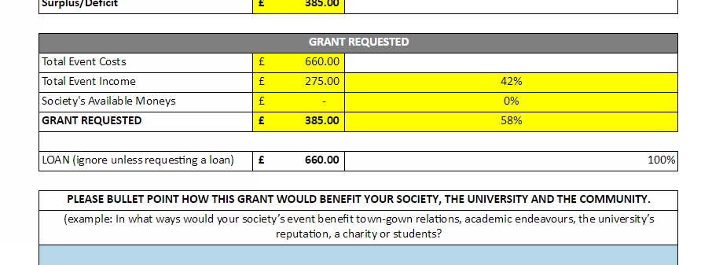
Grant Request
This shows how much grant money you would need to run your event.
This percentage shows what percent of the event the Societies Committee is funding.
We generally don’t like to fund more than 55% but we assess every grant individually.
This is where we look at the merit of the event
(see next slide).

Slide 31
Merit of Event
Consider the merit of the event to the Association the Society
Think about things like
Town-gown relations
Benefit to the University community
Academic relevance
University and Association’s Reputation
Charitable benefits
Cultural enrichment
Health, Wellbeing and Welfare
Demonstrate it’s valuable to YOUR society
How much time are you putting into the organization
How much money is the society/ are the members putting in themselves?
Do any external bodies endorse the event?

Slide 32
Societies Committee Loans
Any society may apply for a loan to meet temporary cash flow needs
The loan shall be interest free, provided that the loan is repaid in full by the date specified for repayment and all loans are generally to be repaid in a single installment
A society’s committee has to vote to authorise their treasurer to apply for a loan
Outstanding loans have to be reported at AGMs and to new members before paying membership fees.
If a loan is not paid back, the executive committee of the society is liable for the debt and may be referred to the SSC Discipline Committee

Slide 33
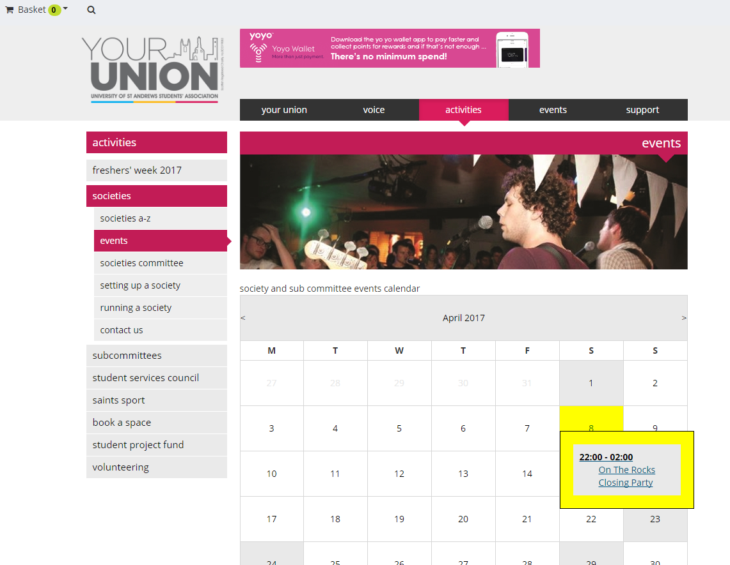
Societies’
Calendar
The Societies Committee is happy to help advertise society events on the YourUnion website society calendar.
Submit info about your event or just a Facebook event link to socs@

Slide 34
5. Anti-Fraud Practices

Slide 35
Anti-fraud Principles
The officers of societies have a duty to prevent fraud
Fraud includes:
Embezzlement of society funds
Misappropriation of society funds
Filing grant applications based on willfully false or misleading information
Any deceit used to gain a dishonest advantage
Societies must develop internal control procedures to remove the opportunity to commit fraud
Fraud allegations are pursued and investigated internally, civilly, and criminally.

Slide 36
Good Practices
Update your records immediately after an event or as soon as you are given a receipt
Ensure that the appropriate officers/committee authorise and are aware of all expenditures
Retain all financial records
Review financial transactions frequently and ensure that all transactions appear appropriate
Try to use cheques for payment where possible

Slide 37
Reporting Fraud
IMMEDIATELY REPORT ANY SUSPICIOUS TRANSACTION OR ACTIVITY TO THE CASH OFFICE
The Association can investigate the accounts and practices of a society to prevent fraud, but only if the matter is raised to our attention
Allegations will be handled confidentially

Slide 38
Email Fraud Threats
Societies in the University have been targeted for Email Fraud
The criminals pretend to be one of the exec, emailing (usually) the treasurer, demanding urgent payment to a third party. They will include a bank account and sort code
This is an real example of the type of email that societies have received;
{treasurer’s name}, I need you to initiate a payment of £2,100 now, get back to me if you are available
when questioned, this comes through:
I am in a meeting now. It's a payment to a vendor for an outstanding payment for purchase, supporting document will be sent across to you before the end of the week. It has to go out now. Will send you the beneficiary details in my next email.

Slide 39
What to do
If you see this sort of request and you are unsure, wait until you can verify it – ideally face to face with the person, or over a phone number that you already have
Only reply to known email addresses (it may look like the right address, double check)
Don’t give out extra information (only …. can deal with that, we only allow payments up to….)
Report such attempts to;
phishing@st-andrews.ac.uk

Slide 40
Summary

Slide 41
Core Responsibilities
Keep a cash book record, including details and proof of all expenditure, and income, also keep all bank statements for the past 7 years.
Ensure the cash box and high value assets are insured appropriately
Check society pigeon holes for post and bank statements
Submit accounts for biannual audit, including an Association grant report in May
Present an Yearly Financial report at the AGM
Budget for events
Pursue sponsorship and Societies Committee grants
Look after your society's financial interest and protect against fraud

Slide 42
Finally
Please get in contact with any questions or problems
Societies Committee Office Hours on Tuesdays 4-6pm in Main Bar
Email socgrant@
Please apply for grants!

Slide 43
Treasurer's Competency Assessment

Slide 44
© 2016-17 University of St Andrews Students’ Association SSC Societies Committee The University of St Andrews Students’ Association is a registered charity (No. SC019883)

