Slide 1
Society Health & Safety Training
University of St Andrews Students’ Association
SSC Societies Committee
The University of St Andrews Students’ Association is a registered charity (No. SC019883)
2019 - 2020

Slide 2
Successful Risk Management

Slide 3
Successful Risk Management
The careful consideration of hazards presented by the operations of a society seeks to identify and disclose risks posed to the health and safety of their members, as well as the general public.
Ensure, to the maximum capabilities of committee members that risks identified are mitigated during all official society undertakings.
Notes:
Aims:
Safeguard the Society
Protect members
Prevent collateral damage
Identify the hazards
Assess the risks posed
Implement control measures

Slide 4
Risk Assessment Basics

Slide 5
General Risk Assessment (GRA)
All societies MUST submit a General Risk Assessment as part of their annual affiliation paperwork.
Societies must include in their GRA:
Thorough analysis of all hazards posed to society members, guests, and persons in the vicinity of ordinary undertakings; and
Commitment to a plan of action for reducing the risk posed as far as is reasonably practicable.
GRAs can be edited each year or as required by sending amendments to unionra@.

Slide 6
Supplemental Risk Assessment (SRA)
Under ANY circumstance in which societies undertake any unusual, extraordinary, dangerous, or new activity – in addition to any undertaking that might reasonably be understood to present different hazards than those disclosed in the GRA – MUST submit a supplemental risk assessment.
Due no later than 14 days before event!!
If you fail to submit a risk assessment in adequate time you will not be able to collect any grant awarded and your event will not be covered by liability insurance.
Must be submitted by electronic copy to unionra@.
Notes:
Just as with a GRA, Societies must include in their SRA:
A thorough analysis of all hazards posed to society members, guests, and persons in the vicinity of ordinary undertakings; and
Commitment to a plan of action for mitigating the same.
Late submission may result in withholding of any grant award.

Slide 7
Why do we need to do a risk assessment?
To safeguard society members against injury or ill health.
To prove that you are properly managing any risks from your activities.
You should be able to show from your assessment that:
A proper check was made.
All people who could be affected were considered.
All significant risks were assessed.
The precautions are reasonable.
The remaining risk is as low as is practicable.

Slide 8
What risks should you assess?
Your risk assessment should include consideration of what might cause harm and how, as well as the people who might be affected.
It should take into account any controls which are already in place and identify what, if any, further controls are required.
You do not need to include insignificant risks.
You do not need to include risks from everyday life unless your activities increase the risk.

Slide 9
What is a hazard?
A hazard is anything that may cause harm.
Examples include fire, chemicals, electricity, working from ladders, noise, etc.

Slide 10
What is a risk?
Risk is a combination of the chance, high or low, of someone being harmed by the hazard and how serious the harm could be.

Slide 11
How to do a risk assessment?
To do a risk assessment, you need to understand what, in your activities, might cause harm to people and decide whether you are doing enough to prevent that harm.
Once you have decided that, you need to identify and prioritise putting in place, appropriate and sensible control measures
Notes:
Deal with high risks first
Death
Serious injury

Slide 12
5 Steps for your Risk Assessment
Identify the hazards of your activities.
Decide who might be harmed and how.
Evaluate the risk and decide on precautions.
Record your findings.
Review and update.

Slide 13
Identify the Hazards
What are the foreseeable hazards, risks and dangers? Also, don’t forget about long-term health hazards!
Think about what you are going to do.
What hazards can you foresee?
Visit the location of your activity.
Are there any environmental hazards?

Slide 14
Decide Who Might Be Harmed and How
Identify groups of people. Don’t forget about people not directly involved in your society event/activity!
Who is affected by the activity?
Society members, public, anyone else?
How might these people be harmed?
What harm could the hazards cause?
Notes:
Identify groups of people effected.
Don’t forget people this can include people not directly involved in your society event/activity.
Special attention may be required for
People with disabilities
Pregnant people
Inexperienced members

Slide 15
Evaluate the Risk and Decide On Precautions
Decide how severe the harm could be.
Slight, Moderate, extreme
Decide how likely it is that harm could occur.
Very unlikely, Unlikely, Likely, Very likely
List what is already in place to reduce the likelihood of harm or make any harm less serious.
Decide on further control measures.
Your risk assessment should only include what you could reasonably be expected to know - you are not expected to anticipate unforeseeable risks.
Notes:
REASONABLY PRACTICABLE
This means balancing the level of risk against the measures needed to control the real risk in terms of money, time or trouble. However, you do not need to take action if it would be grossly disproportionate to the level of risk.
List what is already in place to reduce the likelihood of harm or make any harm less serious.
Indicate the level of harm and how likely it is to occur.
HARM
Slight; Examples of slight harm include superficial injuries, minor cuts, bruises and temporary discomfort.
Moderate; Examples of moderate harm include burns, concussion, serious sprains, minor fractures, dermatitis, asthma and musculoskeletal disorders.
Extreme; Examples of extreme harm include major fractures, poisonings, multiple injuries, fatal injuries and occupational cancer.
LIKELYHOOD
Very unlikely; Very unlikely means there is less than a 1% chance of the risk being experienced by an individual during the lifetime of an individual undertaking the activity.
Unlikely; Unlikely means the risk is typically experienced once during the lifetime of an individual undertaking the activity.
Likely; Likely means the risk is typically experienced once every five years by an individual undertaking the activity.
Very likely; Very unlikely means the risk is typically experienced at least once every six months by an individual undertaking the activity.
Remember to prioritise. Deal with those hazards that are high-risk and have serious consequences first.
Also consider the number of people exposed.
Hierarchy of control
Remove the hazard
Use a less risky option
Prevent access to the hazard
Reduce exposure to the hazard
Use PPE

Slide 16
Record Your Findings
Complete the risk assessment form and email it to unionra@.
Notes:
Retention period 3 years
to comply with health and safety law
to provide proof of having carried out a risk assessment
to provide as evidence in the event of an insurance claim or in case of criminal or civil actions
so that everyone can see what needs to be done to keep people safe and healthy

Slide 17
Review Your Risk Assessment and Update
Annually at re-affiliation.
If anything has changed.
If there has been an accident or incident.

Slide 18
Some Common Hazards
Fire
Slips, Trips and Falls
Electricity
Manual Handling
Falls from Height
Vehicles and Transport
Noise
Violence
Bad Weather

Slide 19
GRA Example

Slide 20
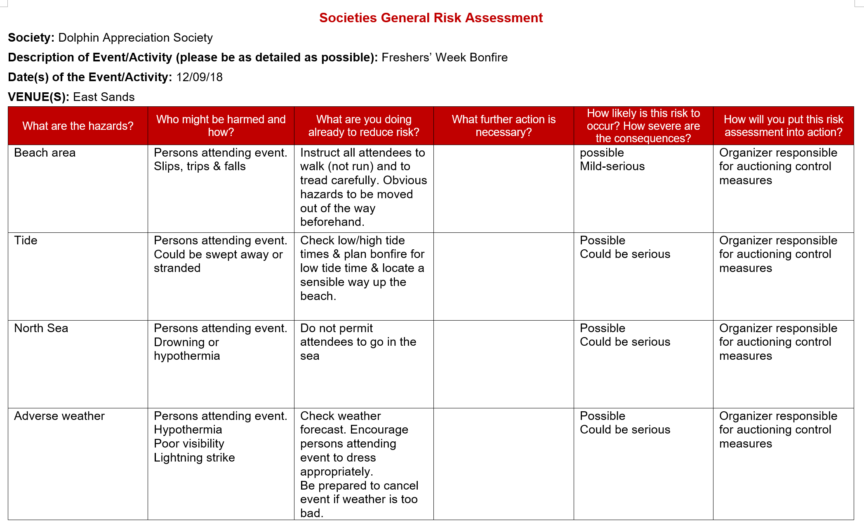

Slide 21
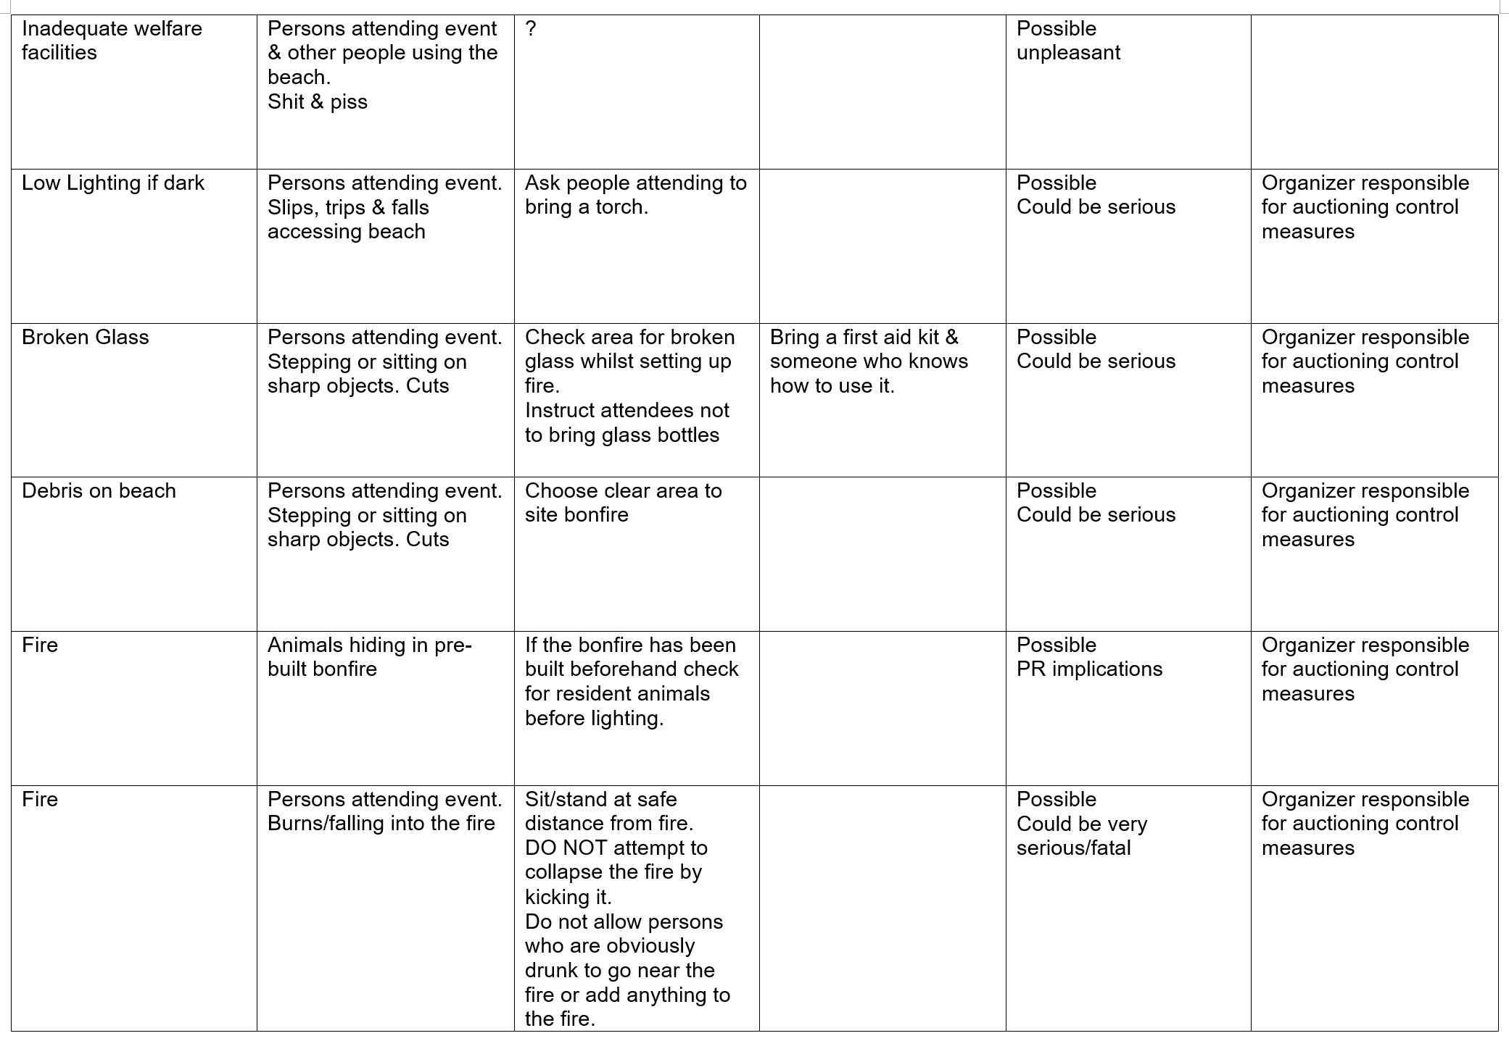
Notes:
DO NOT USE PALLETS AS FUEL THEY ARE FULL OF NAILS
DO NOT BURY HOT EMBERS
CLEAR UP YOUR RUBBISH

Slide 22
Formal Obligations

Slide 23
Accident and Incidents
You must report accidents and/or incidents in writing to union@ as soon as is practicable.
For example, you must inform the Union if someone on a society trip falls out of a caravan window and breaks their arm.

Slide 24
Trips Abroad
Prior to any official or quasi-official trip abroad societies must contact Student Services and notify them to that effect, as well as liaise with them as is necessary.
Societies must do this in addition to filling out a Supplemental Risk Assessment (SRA).
Notes:
Checklist for society trips abroad
Remember to assess travel risk in UK prior to departure

Slide 25
Use of Private Residences for Official Business
Private residences are suitable for society use ONLY when a society has petitioned for, and been subsequently granted leave to proceed, by the Societies Committee.
Email socs@
However, societies may, without formal exemption, conduct committee meetings of ten or fewer persons in a private residence so long as the activities therein are specifically related to ordinary committee meeting matters.
Notes:
Soc events in private residences could invalidate your lease.
They won’t have liability insuarnce
If any thing goes wrong during an unauthorized event the organizer will be the one responsible

Slide 26
Serving Alcohol
If you require alcohol at an unlicensed venue, you must apply for a license at least 6 weeks in advance.
Email sabars@ about getting a license, or come into the Union and speak to the bar manager.

Slide 27
Why Risk Assessments Matter
https://www.dailypost.co.uk/news/north-wales-news/llangollen-bike-race-spectator-death-13693286
Notes:
29-year-old spectator Judith Garrett, who had been at the event to watch her boyfriend compete was fatally injured.
The incident occurred in August 2014
The was heard in June 2018
The British Cycling Federation, it failed to conduct its undertaking in such a way as to ensure the health and safety of people attending.
A marshal, Kevin Ian Duckworth, is alleged to have failed to ensure that his health and safety duties as a marshal were complied with.
Race organizer Michael Marsden, is alleged to have failed to conduct the event in such a way that people were not exposed to risk. It is alleged that he failed to ensure the safety of spectators at the competition and failed to provide marshals with adequate training regarding the safety of spectators.
The final charge alleges that he failed to report the death of Miss Garrett.
26 June 18 Marshall cleared of charges
4 July 18 Organizer & British Cycling cleared of charges

Slide 28
Risk Assessment is not about
Stopping recreational and/or learning activities for individuals where the risks are managed;
Scaring people by exaggerating or publicising trivial risks;
Generating useless paperwork mountains.

Slide 29
Good risk assessment is about
Preventing people being killed or injured;
Enabling events to proceed;
Reducing significant risks or ensuring they are effectively managed;
Reducing your exposure to legal action (Criminal or Civil) or insurance claim.

Slide 30
Forms and Information Access
All documents discussed in this session may be accessed electronically via the Students’ Association website:
https://www.yourunion.net/activities/societies/landingpage/
Health & Safety Executive: http://www.hse.gov.uk/

Slide 31
Important Contacts

Slide 32
Don’t hesitate to get in contact!
Director of Student Development & Activities – dosda@
Phil Hulse – Deputy Building Supervisor – prh@
SSC Societies Officer – socs@
Risk Assessment Submission – unionra@

