Slide 1
HEALTH & SAFETY AWARENESS SESSION
Student Services Council: Societies Committee
University of St. Andrews Students’ Association

Slide 2
CRITICAL CONTACTS
Societies Committee Events Officer: Lottie Haswell-West
socevents@st-andrews.ac.uk
SSC Societies Officer: Kevin Phelan
socs@st-andrews.ac.uk
Director of Student Development & Activities: Charlotte Flatley
dosda@st-andrews.ac.uk
Students’ Association Building Supervisor: Bruce Turner
det8@st-andrews.ac.uk
Students’ Association Deputy Building Supervisor: Phil Hulse
prh@st-andrews.ac.uk

Slide 3
TRAINING SESSION OUTLINE
Successful Risk Management Paradigms
Formal Obligations
General Risk Assessment
Supplemental Risk Assessment
Trips Abroad
Use of Private Residences for Official Business
Serving Alcohol
Forms and Information Access
Example Risk Assessment Form

Slide 4
SUCCESSFUL RISK MANAGEMENT
The careful consideration of hazards presented by the operations of a society seeks to identify and disclose risks posed to the health and safety of their members, as well as the general public.
Ensure, to the maximum capabilities of committee members that risks identified are mitigated during all official society undertakings.
Risk management, in this regard, is thus composed of a process of conceptualisation, calculation, and actualisation.
Aims:
Safeguard the Society Protect members Prevent collateral damage

Slide 5
FORMAL OBLIGATIONS
General Risk Assessment (GRA)
All societies MUST submit a General Risk Assessment as part of their annual affiliation paperwork.
Societies must include in their GRA:
Thorough analysis of all hazards posed to society members, guests, and persons in the vicinity of ordinary undertakings; and
Commitment to a plan of action for lessening the same.
Due on the annual Re-Affiliation Deadline!!
Must be submitted in hard copy to the General Office, the Societies Officer, or the Secretary to the Committee alongside other affiliation paperwork.
GRAs can be edited each year or as required by sending amendments to socs@

Slide 6
General Risk Assessment Form
1. What are the hazards of your regular activities?
What are the foreseeable hazards, risks and dangers? Also, don't forget long-term health hazards.
2. Who might be harmed and how?
Identify groups of people. Don’t forget people this can include people not directly involved in your society event/activity.
3. What are you doing already to reduce risk? What further action is necessary?
List what is already in place to reduce the likelihood of harm or make any harm less serious.
4. How likely is this risk to occur? How severe are the consequences?
Indicate the level of hazard (not serious/serious/very serious) and how likely it is to occur (not likely/likely/very likely).
5. How will you put this risk assessment into action?
Remember to prioritise. Deal with those hazards that are high-risk and have serious consequences first.

Slide 7
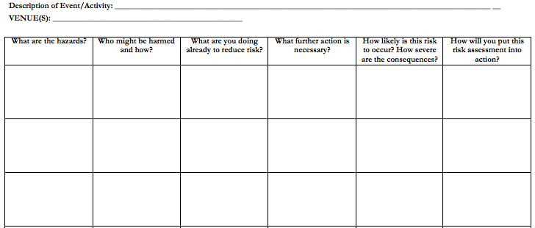
Societies General Risk Assessment

Slide 8
Example 1: General Risk Assessment for a Bonfire
Is this enough? Have they identified all the hazards/risks?

Slide 9
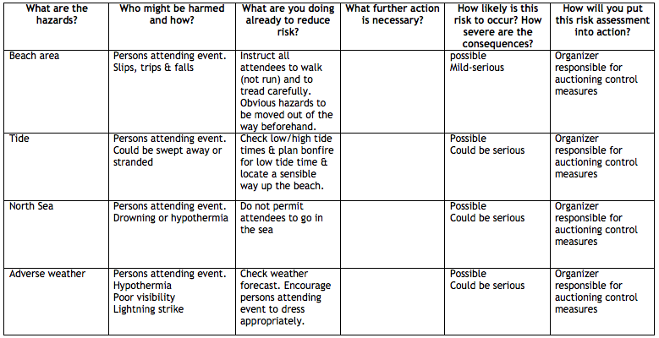
Example 2: General Risk Assessment for a Bonfire

Slide 10
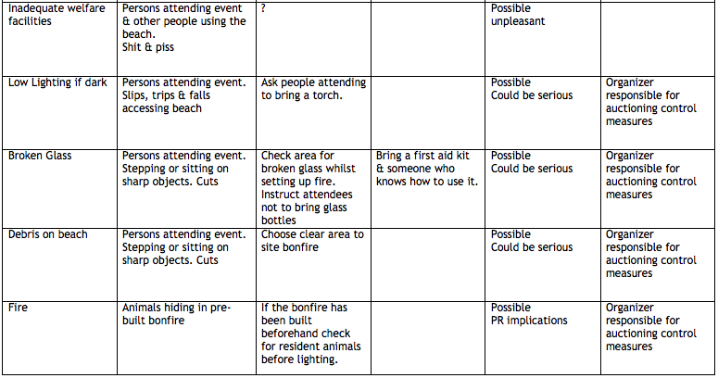
Example 2: General Risk Assessment for a Bonfire

Slide 11
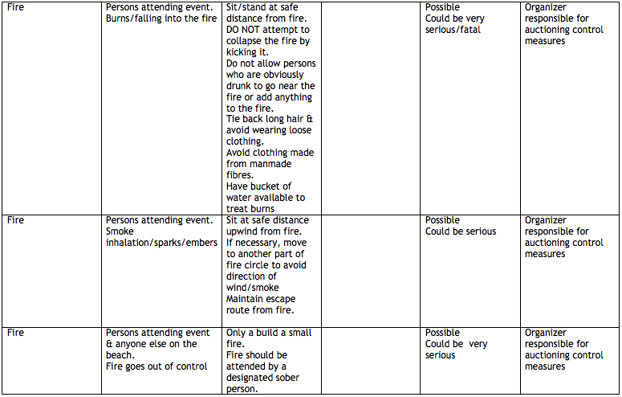
Example 2: General Risk Assessment for a Bonfire
Has everything been covered? Can you think of anything else?

Slide 12
Example 2: General Risk Assessment for a Bonfire
What was missing?
Transport of wood to fire site
Safe disposal of post combustion debris
Make sure you identify as many hazards/risks as possible!
Don’t forget to inform the Societies Committee and Union Management if/when incidents happen as well as any near misses.

Slide 13
Formal Obligations
Supplemental Risk Assessment (SRA)
Under ANY circumstance in which societies undertake any unusual, extraordinary, dangerous, or new activity – in addition to any undertaking that might reasonably be understood to present different hazards than those disclosed in the GRA – MUST submit a supplemental risk assessment.
Just as with a GRA, in a SRA Societies must include:
A thorough analysis of all hazards posed to society members, guests, and persons in the vicinity of ordinary undertakings; and
Commitment to a plan of action for mitigating the same.
Due no later than 14 days before event!!
Must be submitted by electronic copy to the Events Officer (socevent@), or the Secretary to the Committee.

Slide 14
Formal Obligations
Trips Abroad
Prior to any official or quasi-official trip abroad societies must contact Student Services and notify them to that effect, as well as liaise with them as is necessary.
Societies must do this in addition to filling out an Supplemental Risk Assessment.

Slide 15
Formal Obligations
Use of Private Residences for Official Business
Private residences are suitable for society use ONLY when a society has petitioned for, and been subsequently granted leave to proceed, by the Societies Committee.
However, societies may, without formal exemption, conduct committee meetings of ten or fewer persons in a private residence so long as the activities therein are specifically related to ordinary committee meeting matters.

Slide 16
Formal Obligations
Serving Alcohol
If you require alcohol at an unlicensed venue, you must apply for a license at least 6 weeks in advance
Email Tony, Union’s Commercial Manager, via am350@st-andrews.ac.uk about getting a license, or come into the Union and speak to them.

Slide 17
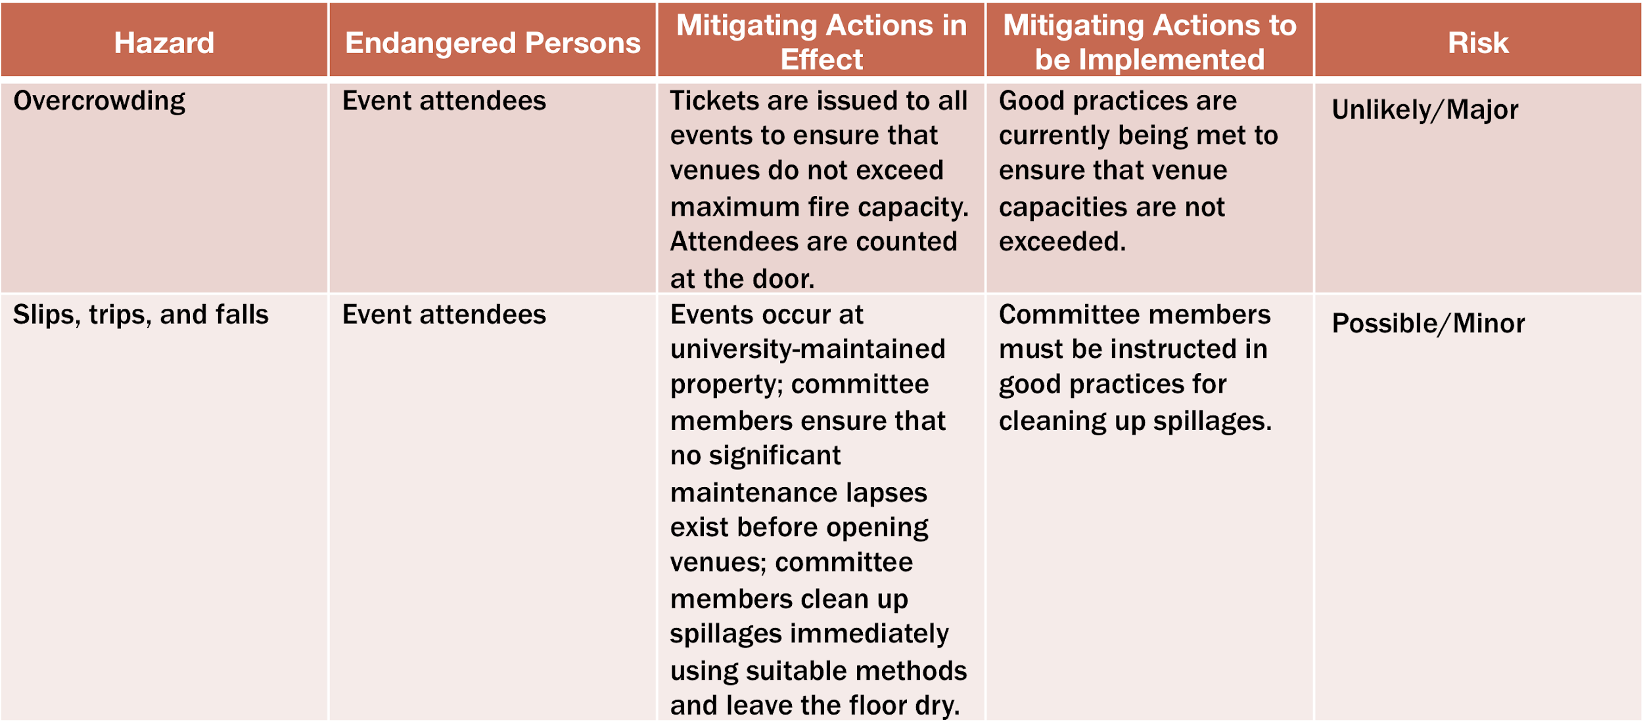
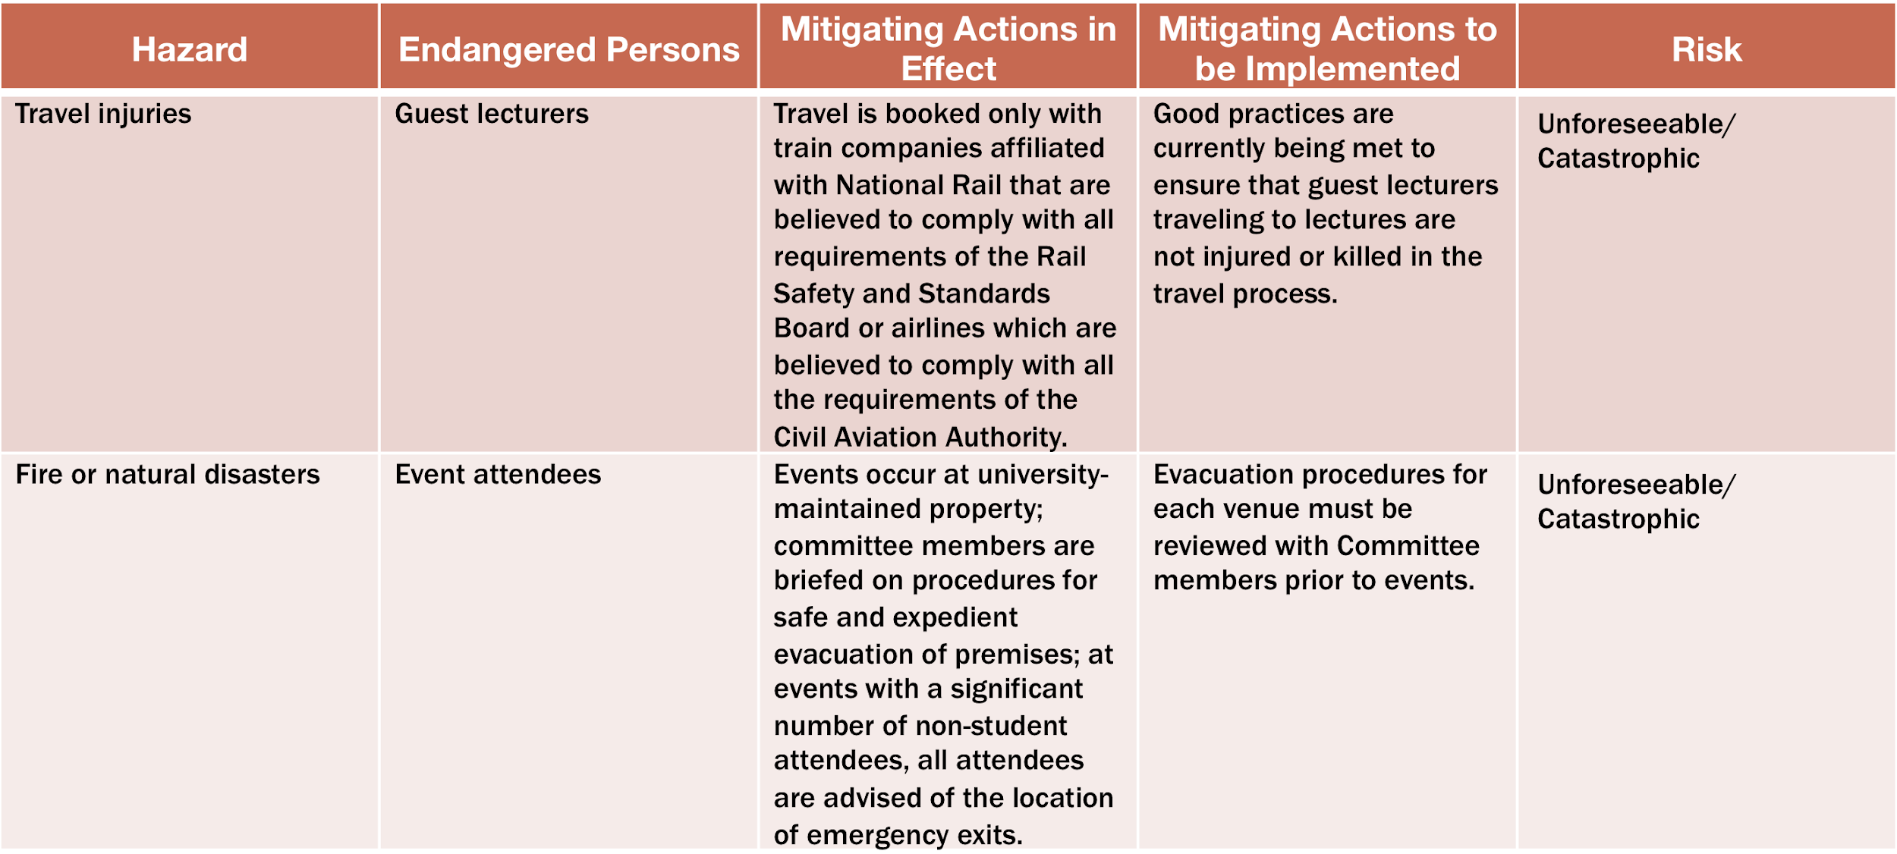

Slide 18
Forms and Information Access
All documents noted herein may be accessed in electronic form via the Students’ Association website

Slide 19
HEALTH & SAFETY AWARENESS SESSION
Student Services Council: Societies Committee
University of St. Andrews Students’ Association

