Slide 1

Treasurer Training
Society’s Treasurer
Training
University of St Andrews Students’ Association
Charity Number: SC019883

Slide 2
Treasurers and Banking

Slide 3



The Role of Treasurer
Responsible for the Financial Management of the Society
Monitoring and managing the misappropriation of funds and debts that the Society may incur and is liable for
Engaging with the Societies Committee and Cash Office to avoid getting into any financial trouble

Slide 4




Bank Accounts
Societies should only have ONE Bank Account
If you have more than one Account, you MUST declare this to the Cash Office and Societies Committee
If you would like another you MUST ask the Societies Committee
We would recommend for all the Bank of Scotland for all Bank Accounts

Slide 5


Signatories
Remove old Signatories and add 2 newly elected committee members, usually President and Treasurer
You must have at least four signatories, the Society Signatories, Chris Clarke and Tanya Barnes
All correspondence should be addressed to the Students’ Association

Slide 6
Account Keeping

Slide 7



Basic Principles
The standard method of accountancy for Societies is Single Entry Book-Keeping where income and expenditure is recorded only once in the Cash Book.
The Cash Book consists of all cash receipts and payments for both society’s petty cash and bank account.
In a Single Entry Book-Keeping system, the cash book is the principal ledger.

Slide 8
Cash Book Examples
No. | Date | Transaction | Cash Income | Cash Expend. | Bank Income | Bank Expend.
01 | DD/MM/YY | Carry-over from 23/24 | £20.00 |  | £250.00
02 | DD/MM/YY | Membership Fees | £60.00 |  | £45.00
03 | DD/MM/YY | Cash to Bank |  | £40.00 | £40.00
04 | DD/MM/YY | Pub Quiz |  | £20.00 |  | £80.00
05 | DD/MM/YY | Merchandise |  |  |  | £170.00
XX | End of 24/25 | Amount for 25/26 | £20.00 |  | £85.00

Slide 9



Records
The Cash Book
All Receipts
The Last 7 Years of Bank Statements
A Lockable Cash Box
Cheque Books
Paying-in Book

Slide 10
Treasurer’s Report
To be given at the AGM but don’t worry this is all on the AGM Checklist!
  Total assets at the time of the previous AGM.
  Total income since the previous AGM.
  Total income from Association grants since the previous AGM.
  Total expenditure since the previous AGM.
  Current total assets.
  Any debts including loans from the Societies Committee.

Slide 11




The Annual Audit
Accounts are due every June.
The Cash Office may request more than one Audit if previous audits are inadequate.
  You Must Submit to the Cash Office:
  All bank statements issued since the previous audit.
  Catalogued receipts for society expenditure since the previous audit.
  Cash Book
  Cheque book and paying-in book.
Ensure that the Cash Box has no more than £20.

Slide 12
Financial Practices
Use of Funds

Slide 13



Permissible Use of Funds
A Society’s Funds are derived exclusively from the members of that Society
A society’s funds may only be used for the benefits of the society as a whole or for the fulfilment of its aims.
No member of the Committee may derive any financial profit or gain by reason of their participation on the Committee, including favourable rates on goods or services, unless the same benefit is available to any and all members of the Society.

Slide 14
Transparency and Accountability
Society accounts must be totally transparent.
Societies are accountable to the Students’ Association and their members for their financial practices.
Accounts must be updated regularly and made available upon request of the Students’ Association or Society members.
They must be maintained in a standard format.
They must document ALL income and expenditure.

Slide 15
Cash Management
Cash may only be handled by those authorised
to do so.
Cash boxes are insured for up to £200.
Cash outside of your box is not insured.
Never keep more than £200 in your cash box for more than 1 day.
The Cash Office can provide floats (change).
The Association can provide secure storage for your cash box overnight or weekends if the balance is more than £200.

Slide 16
Reimbursements
Payment should be made by cheque whenever possible because they are more trackable.
If your Society has online banking, you can also reimburse via bank transfer.
Purchases made by local businesses may be paid from petty cash.
For online purchases, you can use the Cash Office’s credit card and write a cheque to the Association.

Slide 17



Fixed Assets
A fixed asset is a tangible piece of property that a society does not expect to be consumed or sold within one year.
Societies must seek the permission of the Director of Student Development and Activities to sell or otherwise dispose of a fixed asset if purchased with Association funding.
High-value assets may be insured by the union at the discretion of the Cash Office.

Slide 18
Charitable Donations
All charitable donations must be processed through the University of St Andrews Charities Campaign.
Failure to do so will result in penalties!
The donation will still come from your society while also counting towards the Charities Campaign’s fundraising totals.
Email the Charities Campaign if you would like to make a donation or want advice on charitable fundraising events.

Slide 19
Financial Practices
Budgeting

Slide 20
Budgeting Principles
As a treasurer you need to protect your society’s money and oversee financial expenditure.
You should have a budget for every event to ensure they are viable.
INCOME
  Do NOT overestimate income.
  Income should be projected from past events, don’t be overly optimistic.
  Ensure that any sponsorship is guaranteed and available, not just promised.
  Securing cash-flow loans is not recommended. Such loans make the society dependent on the success of the event.

Slide 21
Budgeting Principles
EXPENDITURE
  Include ALL expenditure in your projections.
  Budget for a 10% contingency overrun on ALL expenses, unless you have confirmed invoices
  Include VAT.
Assume, for the purposes of budgeting, that the society will continue to exist and operate indefinitely.
While the society may subsidise an event, it may not jeopardise the financial future of the society.

Slide 22
Good Practices
Do not budget to “break-even”.
Budget to gain at least a small surplus to avoid a deficit.
Create budgets for all events and activities throughout the year and stick to them as nearly as possible.
  Do not wander into a financial commitment without a plan.
Preparing a budget is also an essential part of applying for funding from the Union for an event.

Slide 23
Events

Slide 24
Event Planning Documentation
Documents for events over 100 Participants:
Large-Scale Event Checklist
General Risk Assessment
Third Parties:
For all contractors the Students’ Association must receive at least a copy of their Public Liability Insurance and Risk Assessment.
It is also recommended for large scale events having a face-to-face meeting with the Cash Office.
This must all be completed at least 14 days in advance

Slide 25



Insurance and Liability
It is important to remember that until you have your documentation reviewed and approved the event is uninsured.
The Society would be personally liable for any damages, accidents, illness or injury caused as a result of the operation of an uninsured event.
Furthermore, if your event runs at a loss, the Society members will be personally liable for any costs that are not covered by your income once the event has finished.

Slide 26
Other Important Points
What to do if you have Cash Flow Issues?
  Reach out to the Societies Committee and Cash Office, possibly for a loan
Tickets:
  No FIXR Please – you can sell tickets via our website.
  Do not decide on ticket price until you have all your quotes
Contracts:
  If you are not sure about a contract please talk to the Students’ Association

Slide 27
Funding

Slide 28
Sponsorship
Societies can look for external funding.
This may come from:
  Schools within the University.
  Local businesses.
  External companies and organisations.
Go to the Cash Office to review any sponsorship agreements / contracts with external companies before signing in order to ensure you get a good and fair deal!

Slide 29
Society Committee Grants and Loans
The Societies Committee has a budget of over £30,000 each year, some of this is reserved for Society awards, the rest is given out as Society Grants and Loans
  This money comes from profit in the Union (bars, Rector’s, fayres…).
  This is why when we fund an event we ask you to use Union services where possible.

Slide 30
Applying for Society Committee Grants and Loans
Download the form from the Union website.
Send a risk assessment for your event to unionra@.
Email the completed form and the approved risk assessment to socgrants@ and go to the Societies Committee Office Hours to discuss the grant.
The Societies Committee reviews grants at their weekly meeting. If your grant exceeds £500, you will be asked to present the grant to the committee and the Office Hours of the Grants’ Officer.
You will hear back within 3 days. If you get a grant, you will receive a Grant Receipt via email.
You can use the Grant receipt to claim money back for purchases related to the event, bring physical receipts to the Cash Office in the Union, or send an invoice to unionfinance@ asking them to pay directly.

Slide 31
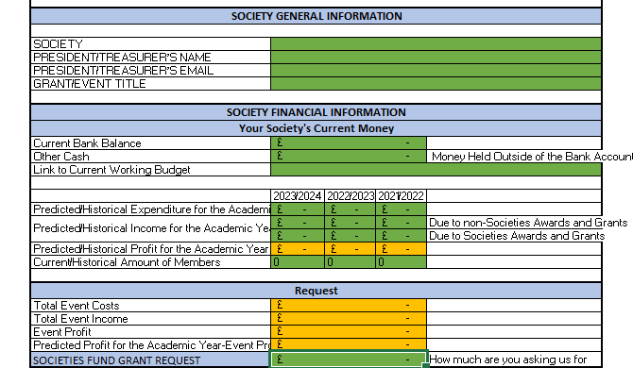
The Grant Form

Slide 32
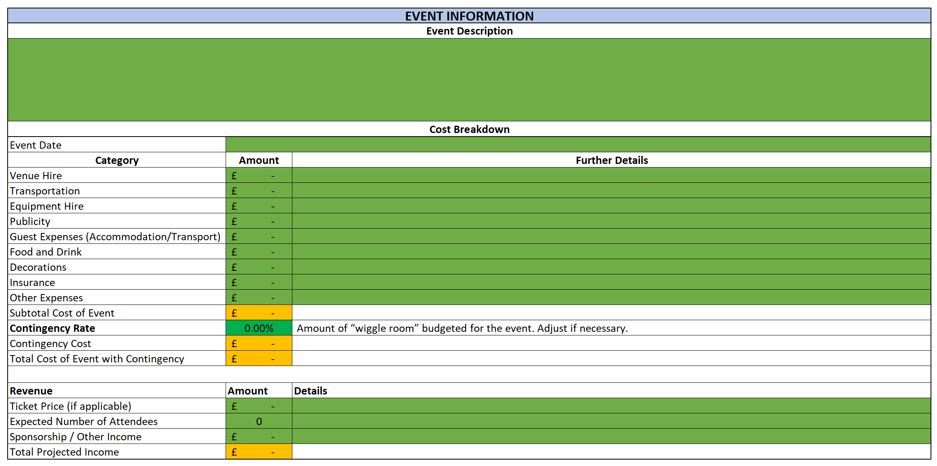
The Grant Form

Slide 33

The Grant Form

Slide 34
The Societies Committee’s Funds Terms of Reference
Any Societies Fund Grant or Loan is given on the fufilment of the purpose of the Societies Fund which is to:
Encourage growth and development of Affiliated Societies by:
  Providing startup funding in the form of grants for new projects and events which would further the aims of the Society but would otherwise pose a financial risk to the Society.
    Societies are expected to use information from the project/event to determine whether it is financially viable for the Society to host independent of external funding.
  Providing startup funding in the form of loans for events expected to provide significant income to the Society.
  Providing grants to improve existing projects and events by altering them in a substantial way compared to past versions of the event/project.
    Societies are expected to use information from the project/event to determine whether it is financially viable for the event/project to incorporate these changes independtly from external funding.

Slide 35
The Societies Committee’s Funds Terms of Reference
Contribute to the Student Experience for students beyond the membership of the Society by:
  Providing grants for projects and events which are open and provide benefit for non members of the Society.
  Providing loans for events which are open and provide benefit for non members of the Society but are expected to make a significant income.
Encourage Collaborative Events and relationships between Allifiated Societies by:
  Providing startup funding in the form of grants for new projects and events hosted by more than one Society.
  Providing grants to improve existing projects and events between more than one Society by altering them in a substantial way compared to past versions of the event/project.
Improve the reputation of the Society or the Students Association with the local Community by:
  Providing grants for projects and events which expect engagement from members of the local community.
  Providing grants for project which provide a service or benefit to the local community.
The Societies Committee will also consider the financial state of the Society when making their decision.

Slide 36
Freshers’ Fund
The Freshers’ Fund consists of leftover money not awarded by the Societies Committee
Not subject to the usual merit and financial need requirements of Society Grants.
Aimed at encouraging Societies to put on events in Freshers Week.
Applications will open over the summer.

Slide 37
Societies Committee Loans
Any society may apply for a loan to meet temporary cash flow needs.
The loan shall be interest free, provided that the loan is repaid in full by the date specified. All loans are generally to be repaid in a single instalment.
A society’s committee has to vote to authorise their treasurer to apply for a loan.
Outstanding loans have to be reported at AGMs and to new members before paying membership fees.
If a loan is not paid back, the executive committee of the society is liable for the debt and may be referred to the Association Discipline Committee.

Slide 38
Other Funds
Students’ Association Funds
Student Project Fund
Freshers’ Fund
Refreshers’ Fund
Employability Fund
Mermaids Performing Arts Fund
Postgraduate Events Fund
University of St Andrews Funds
Anthony Tudor Fund
Rector’s Fund
EDI Fund
Student Activities Fund
Entrepreneurship Centre – Start-up and Spin-out Funding
Scotland’s Future Series
St Leonard College Community Fund
St Leonard College Development Fund

Slide 39
Financial Practices
Anti-Fraud Practices

Slide 40



Anti-Fraud Principles
The Treasurer of the Society have a duty to prevent fraud and create internal processes to mitigate against fraud.
Fraud Includes: Embezzlement, Misappropriation and any Deceit to Gain
Fraud allegations are pursued and investigated internally, civilly, and criminally.

Slide 41
Good Mitigation Practices
Update your records immediately after an event or as soon as you are given a receipt.
Ensure that the appropriate committee members authorise and are aware of all expenditures.
Retain all financial records.
Review financial transactions frequently and ensure that all transactions appear appropriate.
Try to use cheques for payment where possible.

Slide 42


Reporting Fraud
The Association can investigate the accounts and practices of a society to prevent fraud, but only if the matter is raised to our attention.
IMMEDIATELY REPORT ANY SUSPICIOUS TRANSACTION OR ACTIVITY TO THE CASH OFFICE!
Allegations will be handled confidentially.

Slide 43


Email Fraud Threats
Affiliated societies have been targeted for Email Fraud
The criminals pretend to be one of the exec, emailing (usually) the treasurer, demanding urgent payment to a third party. They will include a bank account and sort code
This is a real example of the type of email that societies have received;
  “{treasurer’s name}, I need you to initiate a payment of £2,100 now, get back to me if you are available”
When questioned, this comes through:
  “I am in a meeting now. It's a payment to a vendor for an outstanding payment for purchase, supporting document will be sent across to you before the end of the week. It has to go out now. Will send you the beneficiary details in my next email.”

Slide 44
What to do if you receive Email Fraud!
Step 1
If you see this sort of request and you are unsure, wait until you can verify it – ideally face to face with the person, or over a phone number that you already have.
Step 2
Only reply to known email addresses (it may look like the right address, double check).
Don’t give out extra information (only …. can deal with that, we only allow payments up to….).
Step 4
Step 3
Report such attempts to phishing@.

Slide 45
Financial Practices
Summary

Slide 46
Core Responsibilities
Keep a cash book record, including details and proof of all expenditure and income.
Keep all bank statements for the past 7 years.
Ensure the cash box and high value assets are insured appropriately.
Come to the Cash Office to collect Bank statements and other mail
Submit accounts for annual audit.
Present on Yearly Financial report at the AGM.
Budget for all events.
Pursue sponsorship and Societies Committee funding.

Slide 47
Last, But Not Least: KEY CONTACTS
Director of Student Development & Activities – dosda@
Societies Officer – socs@
Grants Officer – socgrants@
Projects and Events Officer – zg31@
The Cash Office – unionfinance@

Slide 48
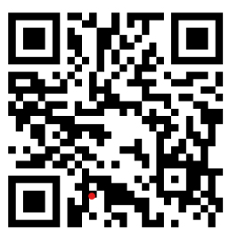
Any Questions?
Treasurers’ Assessment:

