Slide 1
Society President’s Training
University of St Andrews Students’ Association
SRC Societies Committee
The University of St Andrews Students’ Association is a registered charity (No. SC019883)
2022 - 2023

Slide 2
Introduction

Slide 3
How do you become an affiliated society?
List of 15 paid members
Constitution
General Risk Assessment (GRA)
Affiliation Agreement

Slide 4
What do you get as an affiliated society?
You have access to:
Free stall at the Freshers’ / Refreshers’ Fayre
Free room bookings in the Union
Funding from the Societies Committee
Support from the Students’ Association (financial, legal, advisory…)
Public Liability Insurance
Your own webpage, ability to email, add resources, members, tickets and events to yourunion.net
You are expected to:
Follow the Students’ Association Standing Orders
Open membership to all matriculated students
Send a society committee member to relevant trainings

Slide 5
Governance

Slide 6
Constitution
Dictate how your society runs.
Outline society’s main aims and activities.
List committee positions and responsibilities.
List of subcommittees / subgroups (including if they have separate bank account).

Slide 7
Membership
Ordinary Membership must be available for all matriculated students at the University.
You are responsible for keeping track of membership! This can also be done through purchasing membership on the Union's website.

Slide 8
Mailing Lists
When a member first joins the mailing list, you must disclose how you intend to use and store their personal data.
Use the BCC option to send mailing lists.
Members must be able to opt-out of mailing lists. A statement must be written at the bottom of each email on how to unsubscribe.
You are receiving this email because you subscribed to the <society> mailing list. If you would no longer wish to receive these emails, you can unsubscribe here.

Slide 9
Alumni
Alumni can provide support for the society.
Keep legacy membership lists.
Graduating students must consent to be added to alumni mailing lists.

Slide 10
Committee Meetings
You must give at least 24 hours’ notice to committee members before holding a meeting.
The president does not have final say! You can vote on anything as a committee.

Slide 11
General Meetings
You must give 14 days’ notice of any General Meeting to your society members and to the Societies Committee.
Email socelect@
You must complete the AGM / EGM checklist, which will be emailed to you when you notify us.

Slide 12
Elections
Elections are done by single transferable vote (STV), unless your constitution says otherwise.
Only members who have paid membership before notice was sent out can vote or stand for election.

Slide 13
Handovers
Talk to your predecessor!
If you’re a new society, turn to your neighbour and ask them for any tips / advice!
Try to keep a log of all the things you accomplished, how you accomplished them, and why it went well / poorly.

Slide 14
Disputes
The Association can arbitrate disputes between members and a society committee or between two societies.
If you have a dispute with an external organisation or individual, come seek advice from the Director of Student Development and Activities and/or email dosda@.

Slide 15
Union Website
You must keep your society page up to date by:
Uploading your Constitution.
Adding society contact details (i.e. email & social media).
Make sure your committee is up-to-date (this will also give committee members editing rights). Email unionweb@ with any website questions.
Writing a brief description of your society.
*Did you know the societies a – z page is constantly in the top viewed page on yourunion.net? So, please make sure your page is up-to-date!

Slide 16
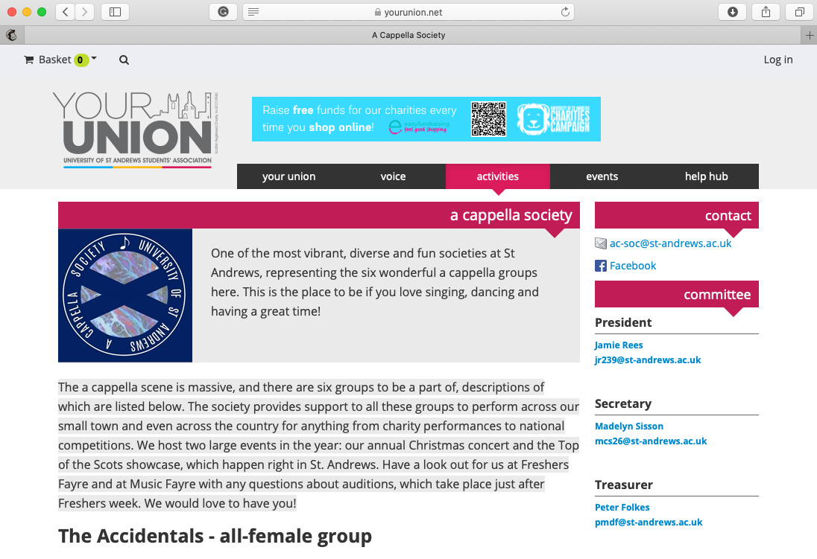
Union Website
Typical society webpage. Find out more about editing your page by visiting
https://www.yourunion.net/activities/societies/manage/website/

Slide 17
Subcommittees
You must declare all positions within subcommittees to socs@ during the re-affiliation process
You must also declare if your subcommittees have separate bank ….accounts to unionfinance@ and socs@

Slide 18
Finance

Slide 19
Banking
Remove old signatures and add newly elected officers as signatories!
You should have at least 4 signatories.
Jillian Cowan (Cash Office Management Accountant)
Dave Whitton (General Manager)
At least 2 of your committee members (usually President and Treasurer)
The mandate (bank form) needs to specify that at least 2 signatories are required for all expenditures.

Slide 20
Banking
If your society has more than one bank account (including subgroups and subcommittees), you must declare them to the Societies Committee.
Email socs@.
Declare them in the re-affiliation form.

Slide 21
Budgeting
Aim for all your events to make a small surplus.
Always include a contingency!
Ensure VAT is included in price quotes.
Project income and expenditure based on previous similar events.
Don’t expect to be able to hold every event for free!

Slide 22
Annual Audit
As part of the affiliation agreement, there will be one audit of financial records at the end of every academic year.
Bring in your books to audit to the Cash Office.
When handing in your books, please ensure your cash box is empty or has a maximum of £20 in it. This will need to be brought in to be checked along with your cash book, bank statements (last 7 years), cheque book, paying-in book, and catalogued receipts.

Slide 23
Funding
As an affiliated society, you can apply for grants from the Societies Committee.
Fill out a grant form and a risk assessment for the event.
Go to the Societies Committee Office Hours.
Email socgrant@ if you have any questions.
Bring receipts to the Cash Office to redeem your grant.
President or treasurer of the society must sign-off on grant receipt.
If you are hosting a careers-based or employability event, you can apply to the Employability Fund.

Slide 24
Charitable Donations
All charitable donations MUST go through the Cash Office!
The Cash Office is open Mon – Fri 9am – 5pm.
For Charitable Societies
If your event is raising awareness, then the Societies Committee can help fund your event.
If your event is aimed at raising funds / donations for charitable organisations, the Societies Committee has £3,000 ringfenced through the Societies Fund to help fund these events.

Slide 25
Events

Slide 26
Room Booking
Email dosda@ to get access to the Union’s room booking system. Your society's President and Treasurer will be added in May, but if you wish to have access earlier, email dosda@.
Check the Resource Booker to see if the space you want is available.
You can book for free up to 6 hours per week, £5 for each additional hour afterwards.
You must fill out a Venue Booking Form to book a commercial venue (i.e. Sandy’s Bar, Beacon Bar, StAge, etc).

Slide 27
Additional Venues
You can book university facilities as an affiliated society.
Please refer to union room booking guide.
You can use commercial venues, but be aware of terms and conditions such as minimum spend and hiring charges.

Slide 28
Public Liability Insurance
Public Liability Insurance is in place in the event that anything goes wrong.
However, your event may not insured if you fail to submit a detailed risk assessment!

Slide 29
Risk Assessments
General Risk Assessments (GRA) are due with affiliation.
MUST cover all regular events for the society (including annual events).
Submit separate sheet of risk assessment for each regular event you host.
Supplemental Risk Assessments (SRA)
MUST be submitted at least 2 weeks before any events that have not been included in your GRA.
One of your jobs is to ensure, as far as is possible, that risks are identified and mitigated during all society undertakings.

Slide 30
Ents
Student Volunteers
They cover all aspects of venue / event set-up.
Lighting, sound, projects, etc.
You must attend an Ents User Meeting at least 2 weeks before the event.
Wednesdays at 1pm in the Meeting Room.
Email ents@ with any questions.

Slide 31
Planning
Check out the Union’s Events Guide.
yourunion.net/handbooks
Any other questions about event planning, contact the Societies Committee.
Email socs@

Slide 32
CEED and Careers Centre
CEED
Develop skills through the Professional Skills Curriculum
Identify specific skills relevant for committee positions
Society Professional Skills Awards, worth £200
Careers Centre
Connect you with alumni speakers
Speak at careers related events
Assist in organising venues
Publicise events

Slide 33
Marketing

Slide 34
Union Societies Calendar
There are a number of resources available to help publicise and plan your events. Visit yourunion.net/handbooks for further information about:
Society and event promotion
Your website profile and online events calendar
Events planning
And more!
All societies have the ability to add events, free tickets, create polls and more via your societies webpage.

Slide 35
Design Team

Slide 36
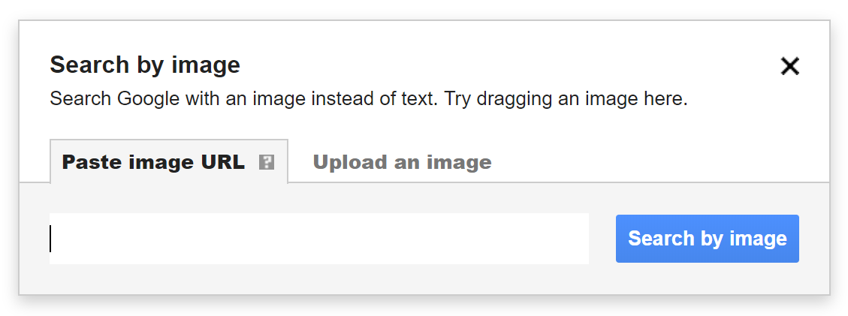
Copyright Infringement
You can get into legal trouble for using a copyrighted image.
Always do a reverse Google image search to find the source.
If photos are signed, contains the photographer name or has a watermark, ask the permission from the owner before you use it.

Slide 37
Societies Committee

Slide 38
Societies Committee
Student Volunteers.
Office Hours are by appointment. Email socs@ to book a slot
Contacts
General Enquiry: socs@
Grants: socgrant@
Elections: socelect@
Affiliations: newsocs@

Slide 39
Society Awards
Celebrates the positive impact societies have made on student life.
Awarded at the end of the year.
Includes cash prizes.
Best Society
Best Event
Most Innovative
Best Online Presence
Best Charitable Society
Best New Society
Community Engagement Award
Most Collaborative Society
CEED Graduate Attributes Society Award
Award for Exceptional Individual Contribution

Slide 40
Important Contacts

Slide 41
Important Contacts
Director of Student Development and Activities – dosda@
Societies Officer – socs@
Cash Office Management Accountant – jc82@
Cash Office – unionfinance@
Risk Assessments – unionra@
Room Booking – sarooms@

Slide 42
Visit yourunion.net/handbooks for more information.

