Slide 1
Society Health & Safety Training
University of St Andrews Students’ Association
SAF Societies Committee
The University of St Andrews Students’ Association is a registered charity (No. SC019883)
2021 - 2022

Slide 2
Introduction

Slide 3
Health and Safety, why do we need to bother?
You are personally responsible for the safety your committee, your society members and anyone attending your events.
You and your committee are liable for any accidents or hazards during an activity or event, whether it’s to yourself, your attendees or even bystanders.
You must ensure your activities and events are safe for everyone and you need to conduct a risk assessment for each one.

Slide 4
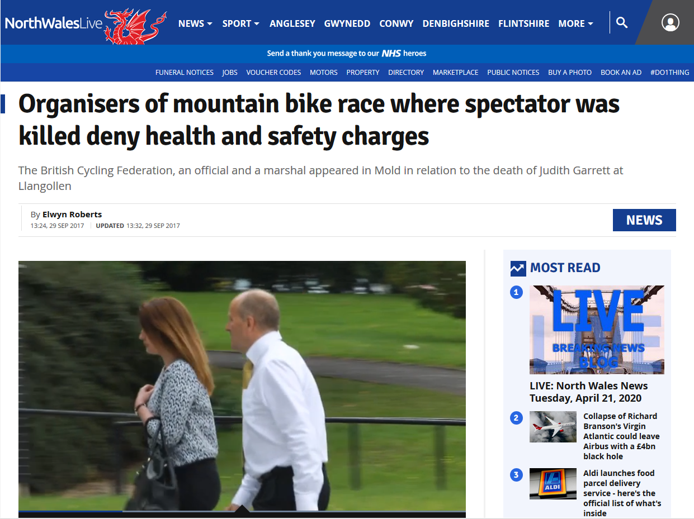
Why Does Health & Safety matter?
Notes:
29-year-old spectator Judith Garrett, who had been at the event to watch her boyfriend compete was fatally injured.
https://www.dailypost.co.uk/news/north-wales-news/llangollen-bike-race-spectator-death-13693286
https://www.shropshirestar.com/news/crime/2018/06/05/womans-death-at-cycle-event-entirely-avoidable-court-told/
The incident occurred in August 2014
The was heard in June 2018
The British Cycling Federation,
Alleged it failed to conduct its undertaking in such a way as to ensure the health and safety of people attending.
Race organizer Michael Marsden,
is alleged to have failed to conduct the event in such a way that people were not exposed to risk.
It is alleged that he failed to ensure the safety of spectators at the competition and failed to provide marshals with adequate training regarding the safety of spectators.
The final charge alleges that he failed to report the death of Miss Garrett.
A marshal, Kevin Ian Duckworth, is alleged to have failed to ensure that his health and safety duties as a marshal were complied with.
26 June 18 Marshall cleared of charges
4 July 18 Organizer & British Cycling cleared of charges

Slide 5
Why Does Health & Safety matter?
29-year-old spectator Judith Garrett, who had been at the event to watch her boyfriend compete was fatally injured.
The incident occurred in August 2014
The was heard in Crown Court in June 2018

Slide 6
Why Does Health & Safety matter?
Those prosecuted
The Governing body, British Cycling
Alleged it failed to conduct its undertaking in such a way as to ensure the health and safety of people attending.

Slide 7
Why Does Health & Safety matter?
Those prosecuted
The organiser, Michael Marsden
Alleged to have failed to conduct the event in such a way that people were not exposed to risk.
Alleged that he failed to ensure the safety of spectators at the competition and failed to provide marshals with adequate training regarding the safety of spectators.
Alleged that he failed to report the death of Miss Garrett.

Slide 8
Why Does Health & Safety matter?
Those prosecuted
A marshal, Kevin Ian Duckworth,
Alleged to have failed to ensure that his health and safety duties as a marshal were complied with (he was allegedly asleep at his post).

Slide 9
Why Does Health & Safety matter?
The outcome
26 June 18 Marshall cleared of charges
4 July 18 Organizer & British Cycling cleared of charges
What happened was a complete accident but one which was completely avoidable
The criminal case took nearly 4 years to conclude.

Slide 10
Why Risk Assessments Matter
A large part of the prosecution & defence cases revolved around the risk assessment process for the event.
It was argued that if the risk assessment had been better;
Adequate control measures would have been in place to protect the spectators.
An accident where someone was killed would not have occurred.
Further reading
https://www.dailypost.co.uk/news/north-wales-news/llangollen-bike-race-spectator-death-13693286
https://www.shropshirestar.com/news/crime/2018/06/05/womans-death-at-cycle-event-entirely-avoidable-court-told/
https://www.dailypost.co.uk/news/devastated-family-mountain-bike-crash-14867765

Slide 11
Why Risk Assessments Matter
If a similar event with similar consequences had been organized by an affiliated society;
The Students Association could have been prosecuted, resulting in fines for the organisation. Fines and/or prison time for staff, officers or trustees on conviction.
The Society office bearers could have been prosecuted, resulting in fines and/or prison time on conviction.
Society members helping at the event could have been prosecuted, resulting in fines and/or prison time on conviction.
A civil claim for damages could have been made, resulting in increased insurance costs or difficulty obtaining future insurance cover meaning some society events could no longer happen.

Slide 12
Risk Assessment

Slide 13
What is a risk assessment?
A systematic process of;
Identifying hazards.
Evaluating any associated risk.
Implementing reasonable control measures to remove or reduce the risk.
A simple example:
Crossing the road
Hazard; Traffic.
Risk; Get hit by a car, could be injured or killed.
Control; Stop at kerb, look both ways, listen for traffic.
Cross road if safe (the green cross code).

Slide 14
Why do we need to do a risk assessment?
To safeguard society members against injury or ill health.
To prove that you are properly managing any risks from your activities.
You should be able to show from your assessment that:
A proper check was made.
All people who could be affected were considered.
All significant risks were assessed.
The precautions are reasonable.
The remaining risk is as low as is practicable.

Slide 15
How do we do a risk assessment?
Think about each activity and break it down into steps.
For each step;
Think what is the hazard?
Who could be harmed & how?
What is the risk from the hazard & what are we doing to minimise the risk?
Write down what you have found.
Check if anything has changed after a period of time e.g. 12 months

Slide 16
How do we do a risk assessment?
5 Steps for your Risk Assessment
Identify the hazards of your activities.
Decide who might be harmed and how.
Evaluate the risk and decide on precautions.
Record your findings.
Review and update.

Slide 17
1. Identify the hazards
Consider a Bonfire at East Sands
What are hazards that you can think of?
Fire (burns),
North Sea (hypothermia/drowning)
Nails from burnt pallets (injuries from standing on nail)
Who might be at risk?
People at the bonfire (Fire, North Sea)
People using the beach after the bonfire is over (nails & debris)
How to minimise these risks?
Delegate someone to make sure people stay a safe distance from the fire & that people don’t go in the sea.
Do Not allow the burning of pallets, clear up after fire is out.
Notes:
Ask questions?

Slide 18
1. Identify the hazards
Some Common Hazards that may be present at an event or activity
Fire
Slips, Trips and Falls
Manual Handling
Electricity
Falls from Height
Noise
Violence
Bad Weather
Drunken Behaviour

Slide 19
1. Identify the hazards
You do not need to include trivial hazards
While they may not be very nice but the following don’t normally present a risk of injury or death so don’t need to be included in a risk assessment
Arguments or disagreements
Disappointments / Unhappy Feelings
Being scared or upset
They are just part of everyday life.

Slide 20
2. Decide Who Might Be Harmed and How
Identify groups of people who could be harmed.
Ask yourself who is affected by the activity?
Society members
Members of the public
Anyone else?
Ask yourself how might these people be harmed by the hazards?
Special attention may be required for
People with disabilities
People who are pregnant
Inexperienced members who may not be familiar with the activity
Notes:
Identify groups of people effected.
Don’t forget people this can include people not directly involved in your society event/activity.
Special attention may be required for
People with disabilities
People who are pregnant
Inexperienced members who may not be familiar with the activity

Slide 21
3. Evaluate the Risk and Decide On Precautions
Decide how severe the harm could be.
Fatality: Death (also includes life changing injury).
Major injury: Major fractures, poisonings, multiple injuries.
Minor injury: Burns, concussion, sprains, minor fractures.
Negligible injury: Superficial injuries, minor cuts and bruises
Trivial injury: Temporary discomfort
Notes:
REASONABLY PRACTICABLE
This means balancing the level of risk against the measures needed to control the real risk in terms of money, time or trouble.
However, you do not need to take action if it would be grossly disproportionate to the level of risk.
List what is already in place to reduce the likelihood of harm or make any harm less serious.
Indicate the level of harm and how likely it is to occur.
SEVERITY OF HARM
Fatality Death!
Major injury Examples of major injury include; major fractures, poisonings, multiple injuries.
Minor Injury Examples of minor injury include; burns, concussion, serious sprains, minor fractures, dermatitis, asthma and musculoskeletal disorders
Negligible injury Examples of negligible injury; include superficial injuries, minor cuts and bruises.
Trivial injury Examples of trivial injuries include temporary discomfort.
LIKELYHOOD
Very likely The risk is typically experienced at least once every six months by an individual undertaking the activity.
Likely The risk is typically experienced once every year by an individual undertaking the activity
Possible The risk is typically experienced once every five years by an individual undertaking the activity
Unlikely The risk is typically experienced once every ten years by an individual undertaking the activity
Highly unlikely There is less than a 1% chance of the risk being experienced by an individual during the lifetime of an individual undertaking the activity
Remember to prioritise. Deal with those hazards that are high-risk and have serious consequences first.
Also consider the number of people exposed.
Hierarchy of control
Remove the hazard
Use a less risky option
Prevent access to the hazard
Reduce exposure to the hazard
Use PPE

Slide 22
3. Evaluate the Risk and Decide On Precautions
Decide how likely it is that harm could occur.
Very likely: Once every 6 months.
Likely: Once a year
Possible: Once every five years
Unlikely: Once every ten years
Highly unlikely: less than a 1% chance of occurrence in a lifetime
Notes:
REASONABLY PRACTICABLE
This means balancing the level of risk against the measures needed to control the real risk in terms of money, time or trouble.
However, you do not need to take action if it would be grossly disproportionate to the level of risk.
List what is already in place to reduce the likelihood of harm or make any harm less serious.
Indicate the level of harm and how likely it is to occur.
SEVERITY OF HARM
Fatality Death!
Major injury Examples of major injury include; major fractures, poisonings, multiple injuries.
Minor Injury Examples of minor injury include; burns, concussion, serious sprains, minor fractures, dermatitis, asthma and musculoskeletal disorders
Negligible injury Examples of negligible injury; include superficial injuries, minor cuts and bruises.
Trivial injury Examples of trivial injuries include temporary discomfort.
LIKELYHOOD
Very likely The risk is typically experienced at least once every six months by an individual undertaking the activity.
Likely The risk is typically experienced once every year by an individual undertaking the activity
Possible The risk is typically experienced once every five years by an individual undertaking the activity
Unlikely The risk is typically experienced once every ten years by an individual undertaking the activity
Highly unlikely There is less than a 1% chance of the risk being experienced by an individual during the lifetime of an individual undertaking the activity
Remember to prioritise. Deal with those hazards that are high-risk and have serious consequences first.
Also consider the number of people exposed.
Hierarchy of control
Remove the hazard
Use a less risky option
Prevent access to the hazard
Reduce exposure to the hazard
Use PPE

Slide 23
3. Evaluate the Risk and Decide On Precautions
List what is already in place to reduce the likelihood of harm or make any consequences less serious.
Remember to prioritise your efforts.
Deal with those hazards that are high-risk and have serious consequences first.
Use a risk matrix to determine the risk taking into account the existing control measures.
Notes:
REASONABLY PRACTICABLE
This means balancing the level of risk against the measures needed to control the real risk in terms of money, time or trouble.
However, you do not need to take action if it would be grossly disproportionate to the level of risk.
List what is already in place to reduce the likelihood of harm or make any harm less serious.
Indicate the level of harm and how likely it is to occur.
SEVERITY OF HARM
Fatality Death!
Major injury Examples of major injury include; major fractures, poisonings, multiple injuries.
Minor Injury Examples of minor injury include; burns, concussion, serious sprains, minor fractures, dermatitis, asthma and musculoskeletal disorders
Negligible injury Examples of negligible injury; include superficial injuries, minor cuts and bruises.
Trivial injury Examples of trivial injuries include temporary discomfort.
LIKELYHOOD
Very likely The risk is typically experienced at least once every six months by an individual undertaking the activity.
Likely The risk is typically experienced once every year by an individual undertaking the activity
Possible The risk is typically experienced once every five years by an individual undertaking the activity
Unlikely The risk is typically experienced once every ten years by an individual undertaking the activity
Highly unlikely There is less than a 1% chance of the risk being experienced by an individual during the lifetime of an individual undertaking the activity
Remember to prioritise. Deal with those hazards that are high-risk and have serious consequences first.
Also consider the number of people exposed.
Hierarchy of control
Remove the hazard
Use a less risky option
Prevent access to the hazard
Reduce exposure to the hazard
Use PPE

Slide 24
3. Evaluate the Risk and Decide On Precautions
Risk matrix
A tool to help you determine the risk of the activity
Plots severity against likelihood & gives a risk value;
High/Medium/Low
Notes:
REASONABLY PRACTICABLE
This means balancing the level of risk against the measures needed to control the real risk in terms of money, time or trouble.
However, you do not need to take action if it would be grossly disproportionate to the level of risk.
List what is already in place to reduce the likelihood of harm or make any harm less serious.
Indicate the level of harm and how likely it is to occur.
SEVERITY OF HARM
Fatality Death!
Major injury Examples of major injury include; major fractures, poisonings, multiple injuries.
Minor Injury Examples of minor injury include; burns, concussion, serious sprains, minor fractures, dermatitis, asthma and musculoskeletal disorders
Negligible injury Examples of negligible injury; include superficial injuries, minor cuts and bruises.
Trivial injury Examples of trivial injuries include temporary discomfort.
LIKELYHOOD
Very likely The risk is typically experienced at least once every six months by an individual undertaking the activity.
Likely The risk is typically experienced once every year by an individual undertaking the activity
Possible The risk is typically experienced once every five years by an individual undertaking the activity
Unlikely The risk is typically experienced once every ten years by an individual undertaking the activity
Highly unlikely There is less than a 1% chance of the risk being experienced by an individual during the lifetime of an individual undertaking the activity
Remember to prioritise. Deal with those hazards that are high-risk and have serious consequences first.
Also consider the number of people exposed.
Hierarchy of control
Remove the hazard
Use a less risky option
Prevent access to the hazard
Reduce exposure to the hazard
Use PPE

Slide 25
3. Evaluate the Risk and Decide On Precautions
Using the results;
High; Further control measures required.
Medium; Further control measures may be required. Monitor
activity & review risk assessment regularly.
Low; Risk adequately controlled. Monitor activity and review
in event of accident or near miss.
Notes:
REASONABLY PRACTICABLE
This means balancing the level of risk against the measures needed to control the real risk in terms of money, time or trouble.
However, you do not need to take action if it would be grossly disproportionate to the level of risk.
List what is already in place to reduce the likelihood of harm or make any harm less serious.
Indicate the level of harm and how likely it is to occur.
SEVERITY OF HARM
Fatality Death!
Major injury Examples of major injury include; major fractures, poisonings, multiple injuries.
Minor Injury Examples of minor injury include; burns, concussion, serious sprains, minor fractures, dermatitis, asthma and musculoskeletal disorders
Negligible injury Examples of negligible injury; include superficial injuries, minor cuts and bruises.
Trivial injury Examples of trivial injuries include temporary discomfort.
LIKELYHOOD
Very likely The risk is typically experienced at least once every six months by an individual undertaking the activity.
Likely The risk is typically experienced once every year by an individual undertaking the activity
Possible The risk is typically experienced once every five years by an individual undertaking the activity
Unlikely The risk is typically experienced once every ten years by an individual undertaking the activity
Highly unlikely There is less than a 1% chance of the risk being experienced by an individual during the lifetime of an individual undertaking the activity
Remember to prioritise. Deal with those hazards that are high-risk and have serious consequences first.
Also consider the number of people exposed.
Hierarchy of control
Remove the hazard
Use a less risky option
Prevent access to the hazard
Reduce exposure to the hazard
Use PPE

Slide 26
3. Evaluate the Risk and Decide On Precautions
Hierarchy of control (actions to reduce risk)
Remove the hazard
Use a less risky option
Prevent access to the hazard
Reduce exposure to the hazard
Use Personal Protective Equipment (PPE)
Using PPE is always the last & least preferable measure as it relies on an individual using the PPE and only protects the person wearing the PPE
Notes:
REASONABLY PRACTICABLE
This means balancing the level of risk against the measures needed to control the real risk in terms of money, time or trouble.
However, you do not need to take action if it would be grossly disproportionate to the level of risk.
List what is already in place to reduce the likelihood of harm or make any harm less serious.
Indicate the level of harm and how likely it is to occur.
SEVERITY OF HARM
Fatality Death!
Major injury Examples of major injury include; major fractures, poisonings, multiple injuries.
Minor Injury Examples of minor injury include; burns, concussion, serious sprains, minor fractures, dermatitis, asthma and musculoskeletal disorders
Negligible injury Examples of negligible injury; include superficial injuries, minor cuts and bruises.
Trivial injury Examples of trivial injuries include temporary discomfort.
LIKELYHOOD
Very likely The risk is typically experienced at least once every six months by an individual undertaking the activity.
Likely The risk is typically experienced once every year by an individual undertaking the activity
Possible The risk is typically experienced once every five years by an individual undertaking the activity
Unlikely The risk is typically experienced once every ten years by an individual undertaking the activity
Highly unlikely There is less than a 1% chance of the risk being experienced by an individual during the lifetime of an individual undertaking the activity
Remember to prioritise. Deal with those hazards that are high-risk and have serious consequences first.
Also consider the number of people exposed.
Hierarchy of control
Remove the hazard
Use a less risky option
Prevent access to the hazard
Reduce exposure to the hazard
Use PPE

Slide 27
3. Evaluate the Risk and Decide On Precautions
Your risk assessment should only include what you could reasonably be expected to know - you are not expected to anticipate unforeseeable risks.
It’s about what is REASONABLY PRACTICABLE
This means balancing the level of risk against the measures needed to control the real risk in terms of money, time or trouble.
However, you do not need to take action if it would be grossly disproportionate to the level of risk.
Notes:
REASONABLY PRACTICABLE
This means balancing the level of risk against the measures needed to control the real risk in terms of money, time or trouble.
However, you do not need to take action if it would be grossly disproportionate to the level of risk.
List what is already in place to reduce the likelihood of harm or make any harm less serious.
Indicate the level of harm and how likely it is to occur.
SEVERITY OF HARM
Fatality Death!
Major injury Examples of major injury include; major fractures, poisonings, multiple injuries.
Minor Injury Examples of minor injury include; burns, concussion, serious sprains, minor fractures, dermatitis, asthma and musculoskeletal disorders
Negligible injury Examples of negligible injury; include superficial injuries, minor cuts and bruises.
Trivial injury Examples of trivial injuries include temporary discomfort.
LIKELYHOOD
Very likely The risk is typically experienced at least once every six months by an individual undertaking the activity.
Likely The risk is typically experienced once every year by an individual undertaking the activity
Possible The risk is typically experienced once every five years by an individual undertaking the activity
Unlikely The risk is typically experienced once every ten years by an individual undertaking the activity
Highly unlikely There is less than a 1% chance of the risk being experienced by an individual during the lifetime of an individual undertaking the activity
Remember to prioritise. Deal with those hazards that are high-risk and have serious consequences first.
Also consider the number of people exposed.
Hierarchy of control
Remove the hazard
Use a less risky option
Prevent access to the hazard
Reduce exposure to the hazard
Use PPE

Slide 28
4. Record Your Findings
Use the template risk assessment at;
www.yourunion.net/activities/societies/runningyoursociety/resources/riskassessments/
The template has sections completed for you.
Edit if required
Complete the risk assessment form and email it to;
unionra@st-andrews.ac.uk
Using the template rather than making your form own means;
All the required information will be included in the RA.
The review process will be faster (at certain points in the year there are multiple GRAs & SRAs from multiple societies to review).
Notes:
Retention period 3 years
To comply with health and safety law
To provide proof of having carried out a risk assessment
To provide as evidence in the event of an insurance claim or in case of criminal or civil actions
To that everyone can see what needs to be done to keep people safe and healthy
To allow the new committee to refert to previous risk assessments

Slide 29
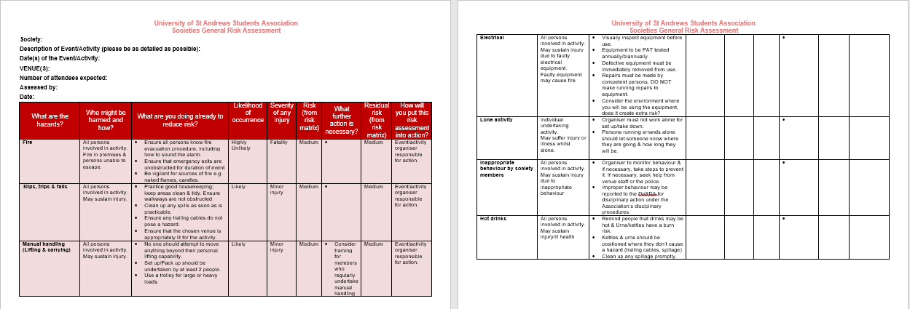
4. Record Your Findings
Template risk assessment
Notes:
Retention period 3 years
To comply with health and safety law
To provide proof of having carried out a risk assessment
To provide as evidence in the event of an insurance claim or in case of criminal or civil actions
To that everyone can see what needs to be done to keep people safe and healthy
To allow the new committee to refer to previous risk assessments

Slide 30
4. Record Your Findings
You need to keep your risk assessments for a period 3 years
To comply with health and safety law
To provide proof of having carried out a risk assessment
To provide as evidence in the event of an insurance claim or in case of criminal or civil actions
So that everyone can see what needs to be done to keep people safe.
To allow the new committee to refer to previous risk assessments and edit them at reaffiliation.
Notes:
Retention period 3 years
To comply with health and safety law
To provide proof of having carried out a risk assessment
To provide as evidence in the event of an insurance claim or in case of criminal or civil actions
To that everyone can see what needs to be done to keep people safe and healthy
To allow the new committee to refer to previous risk assessments

Slide 31
4. Record Your Findings
Circulate the risk assessment
Make the risk assessment available to society members
For higher risk activities make people sign to say they have read it and understood it.
Remember;
The risk assessment is to help keep people safe.
It’s no use if nobody reads it!
It’s still no use if the controls aren’t implemented!!
Notes:
The RA is to keep people safe.
It’s no use if nobody reads it!!!
It’s still no use if the controls aren’t implemented.

Slide 32
5. Review Your Risk Assessment and Update
When should you review & update your risk assessment?
Annually at re-affiliation.
If anything has changed.
If there has been an accident or incident.
Submit any updates to unionra@st-andrews.ac.uk

Slide 33
GRA Example

Slide 34
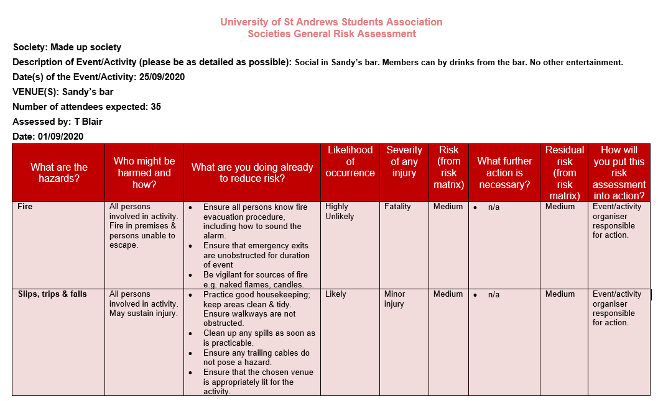
GRA Example

Slide 35
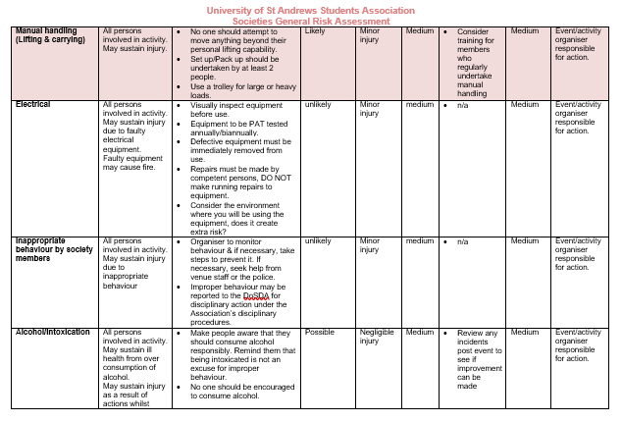
GRA Example

Slide 36
When are Risk Assessments necessary?

Slide 37
General Risk Assessment (GRA)
All societies MUST submit a General Risk Assessment as part of their annual affiliation paperwork.
Your aims & activities declaration must list all regular activities.
Your GRA must include ALL regular activities.
Each activity must have its own risk assessment
i.e. If you have listed 5 regular activities you will have 5 risk assessments.

Slide 38
General Risk Assessment (GRA)
Societies must include in their GRA:
Thorough analysis of all hazards posed to society members, participants, and possible bystanders
A plan of action for reducing the risk posed as far as is reasonably practicable.
GRAs can be edited each year or as required by sending amendments to unionra@st-andrews.ac.uk

Slide 39
Supplemental Risk Assessment (SRA)
Required for events that satisfies one or more of these requirements:
Not covered in GRA
Contains food or drinks prepared by society members / participants
Not located at a union or university venue
Expecting more than 100 participants
Expecting large amount of participants outwith the society
Due no later than 14 days before event!!
If you fail to submit a risk assessment in adequate time you will:
Not be able to collect any grant awarded
Not be covered by liability insurance
Must be submitted by electronic copy to unionra@st-andrews.ac.uk
You MUST NOT proceed with your event until your SRA is approved.
Notes:
Just as with a GRA, Societies must include in their SRA:
A thorough analysis of all hazards posed to society members, guests, and persons in the vicinity of ordinary undertakings; and
Commitment to a plan of action for mitigating the same.
Late submission may result in withholding of any grant award.

Slide 40
Risk Assessment is not about
Stopping recreational and/or learning activities for individuals where the risks are managed.
Stopping people enjoying themselves.
Scaring people by exaggerating or publicising trivial risks;
Generating useless paperwork mountains.

Slide 41
Good Risk Assessment is about
Preventing people being killed or injured.
Enabling events to proceed.
Reducing significant risks.
Ensuring risks are effectively managed.
Reducing your exposure to legal action (Criminal or Civil) or insurance claim

Slide 42
Important Information

Slide 43
Accident and Incidents
You must report accidents and/or incidents in using the form on the union website as soon as possible.
https://www.yourunion.net/activities/societies/runningyoursociety/resources/accidentsorincidentsreports/
For example;
If someone on a society trip falls out of a caravan window and breaks their arm (this accident happened a few years ago).

Slide 44
Accident and Incidents
Accidents & incidents will happen occasionally.
Reporting an accident or incident won’t necessarily result in society activities being stopped.
However;
We need to investigate what happened.
You need to be sure you are doing everything possible to keep everyone as safe as is practicable.

Slide 45
Trips Abroad
Prior to any trip outside of the UK, societies must:
Complete a check list for society trips abroad.
Complete a Supplemental Risk Assessment (SRA).
Remember to assess any travel risk in UK prior to departure.
Notes:
Checklist for society trips abroad, this will help you to complete the supplemental risk assessment.
Remember to assess any travel risk in UK prior to departure

Slide 46
Use of Private Residences
NOT ALLOWED, unless it’s a committee meeting for less than 10 people
Society events in private residences could invalidate your lease.
They won’t have liability insurance.
If any thing goes wrong during an unauthorized event the organizer will be the one held responsible.
For any other event, permission must be given by the Societies Committee Email socs@st-andrews.ac.uk
Notes:
Soc events in private residences could invalidate your lease.
They won’t have liability insurance
If any thing goes wrong during an unauthorized event the organizer will be the one responsible

Slide 47
Serving Alcohol
Any event where you are serving alcohol should be held in a licensed venue e.g. The Union, a pub, a hotel.
You cannot sell or supply alcohol at an event without a alcohol licence.
If you require alcohol at an unlicensed venue, a licence must be applied for at least 6 weeks in advance (determined by Fife Council Licensing Board).
The Union can provide a bar to serve alcohol if your venue doesn’t have a licence, email sabars@st-andrews.ac.uk, or come into the Union and speak to the bar manager.
Remember you need to arrange this at least 6 weeks before your event.
Notes:
Providing alcohol as part of a ticketed event ideally

Slide 48
Forms and Information Access
All documents discussed in this session may be accessed electronically via the Students’ Association website:
https://www.yourunion.net/activities/societies/landingpage/
Additional health & Safety information;
Health & Safety Executive:
http://www.hse.gov.uk/
Royal society for the prevention of accidents:
https://www.rospa.com
Notes:
HSE, the enforcing authority for health & safety
RoSPA; Charity dedicated to accident prevention

Slide 49
Important Contacts

Slide 50
Don’t hesitate to get in contact!
Director of Student Development & Activities – dosda@st-andrews.ac.uk
Phil Hulse – Standing Building Supervisor – prh@st-andrews.ac.uk
Office hour for advice (when in person); Mon – Fri 1400-1500hrs
SAF Societies Officer – socs@st-andrews.ac.uk
Risk Assessment Submission – unionra@st-andrews.ac.uk

Slide 51
Health and Safety Assessment

